Slide 1


Elk Island Public Schools SECONDARY FRENCH IMMERSION Information Night

Slide 2
Le 5 décembre, 2019
Bienvenue et bonsoir!
Welcome and Good Evening!
Notes:
Land and People Acknowledgement
We acknowledge with respect the history and culture of the peoples with whom Treaty 6 was signed and the land upon which Elk Island Public Schools reside. We also acknowledge the traditional homeland of the Métis Nation.
We recognize our responsibility as Treaty members and honour the heritage and gifts of the First Peoples.
We commit to moving forward in partnership with Indigenous communities in a spirit of collaboration and reconciliation

Slide 3
PRESENTERS
Mr. Paul Pallister, Principal, Sherwood Heights Jr. High
Mme MJ Nam, Principal, Ardrossan Jr. Sr. High School
Dany Bazira, Faculte St. Jean

Slide 4
Why continue in EIPS French Immersion Secondary program?
French language learning has a positive effect on English skills
Better overall communicators
Enhances creativity and problem solving skills
Continue their investment in learning
Offers an edge on employment
Increase appreciation of other cultures

Slide 5
French Immersion Junior High within Elk Island Public Schools
Sherwood Heights and Ardrossan both offer a French Immersion (FI) Program for Grades 7 to 9.
Students currently enrolled at Campbelltown are designated to Sherwood Heights.
Students from Ardrossan Elementary and Fort Saskatchewan are designated to Ardrossan.
Ardrossan host the only high school French Immersion program.

Slide 6

Sherwood Heights

Slide 7

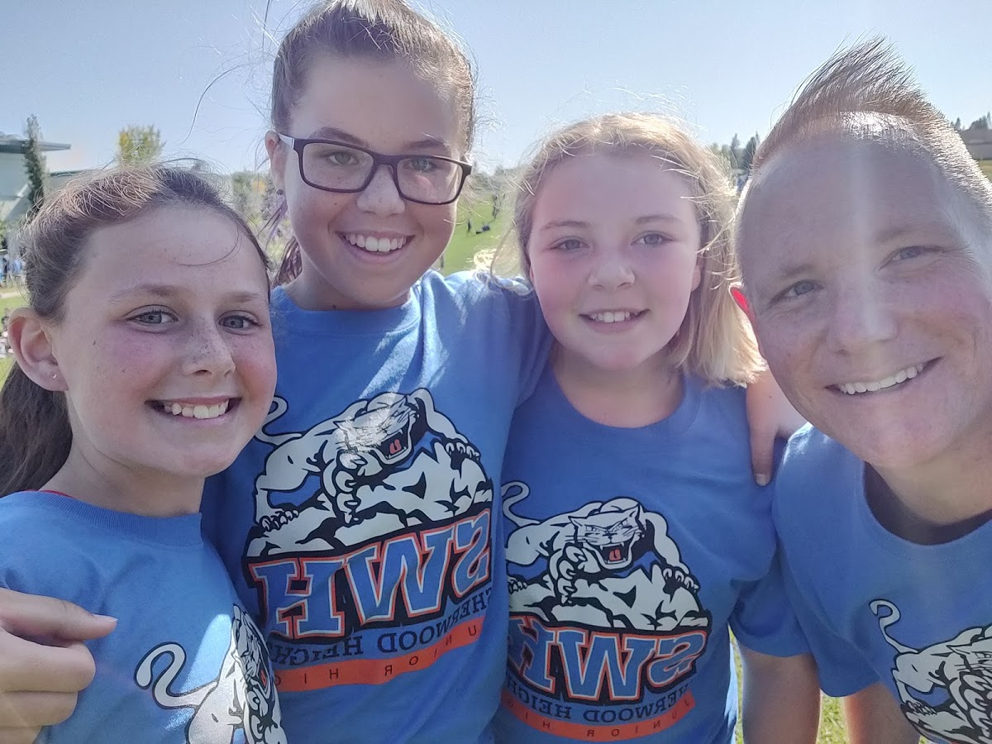

The Junior High Experience at Sherwood Heights

Slide 8

Sherwood Heights Programming
Along with French Immersion, we host the English programs:
LOGOS Christian program
IMPACT – a program for students with learning challenges
Academic Excellence
French Immersion at Sherwood Heights.
We have 8 teaching staff who contribute to French language instruction.
All core classes are in French as well as Health, Reading and sometimes PE
Schedule at Sherwood Heights… what does that mean?
We have an 8 day rotating schedule. Each day is different.
English program students get 6 option classes – 3 each semester
French Immersion students get 4 option classes – 2 each semester
English Language Arts takes the place of 2 options.

Slide 9
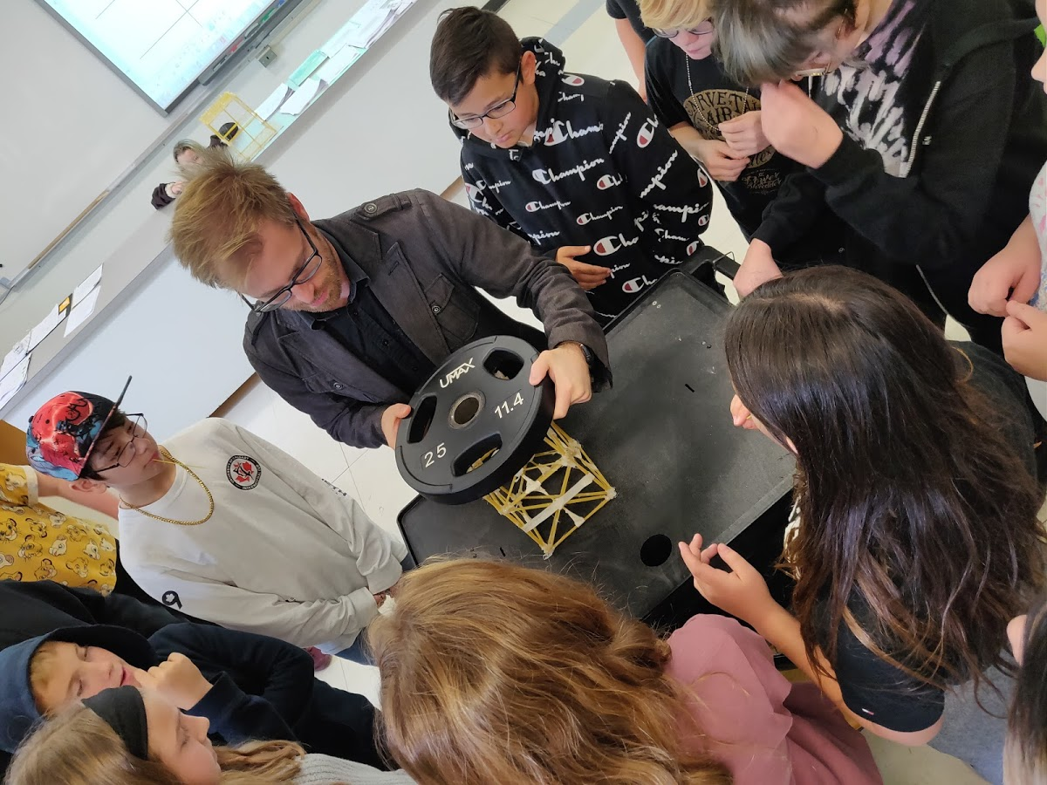
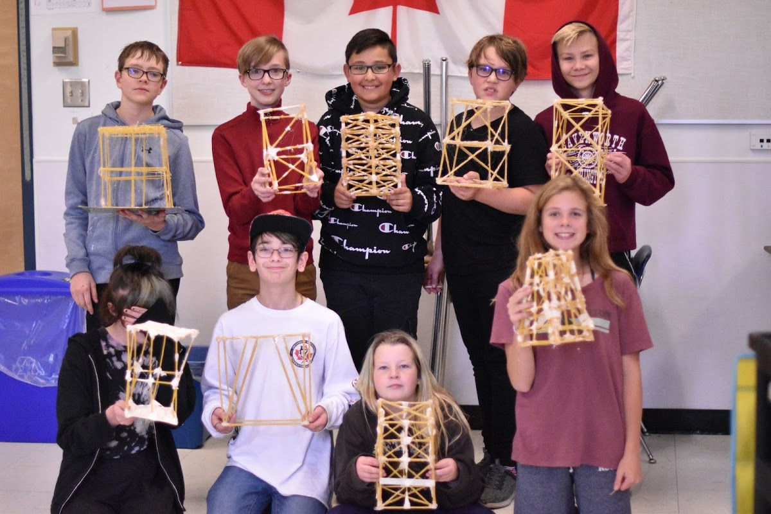
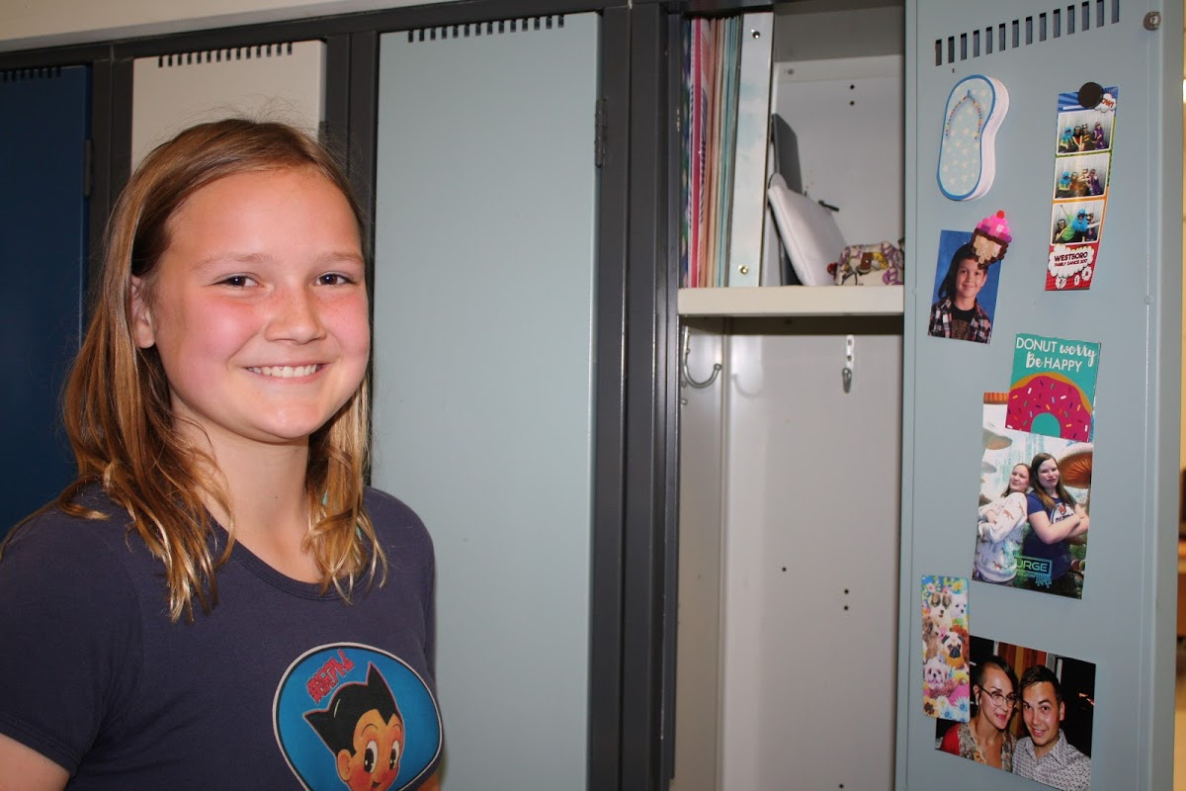
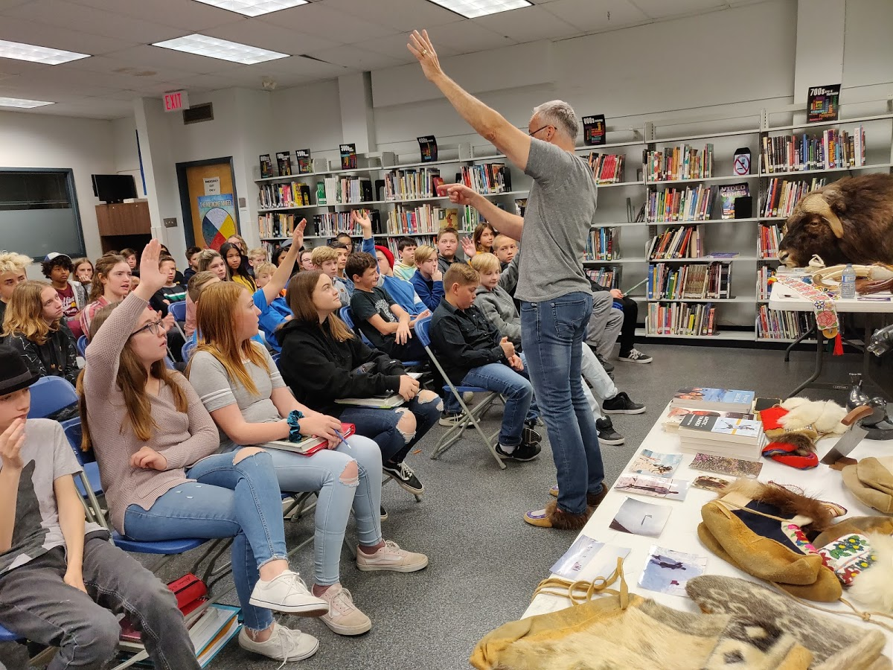
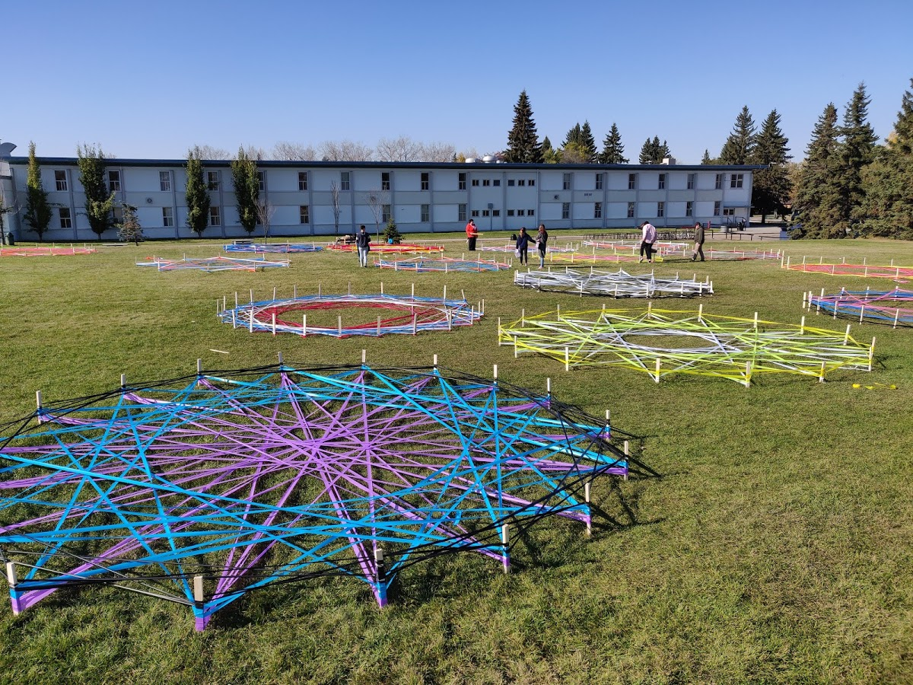

Slide 10
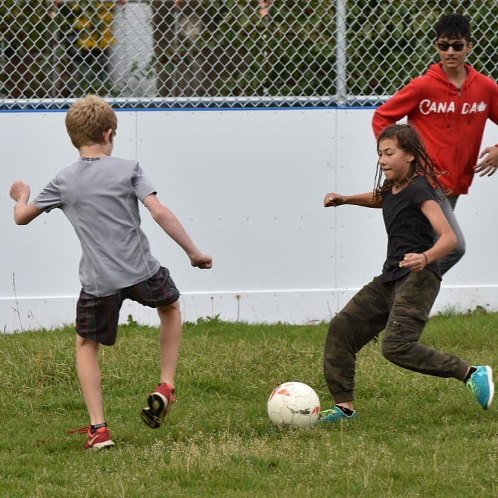
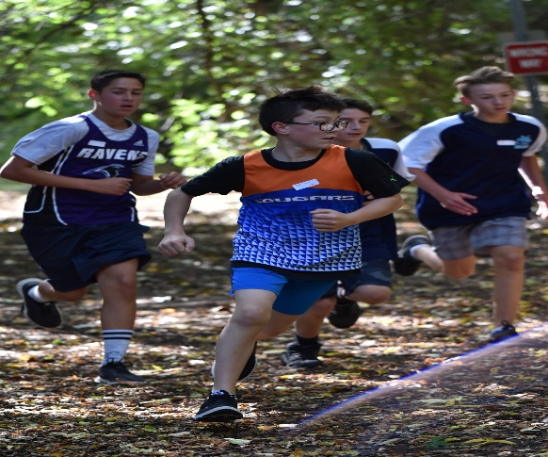
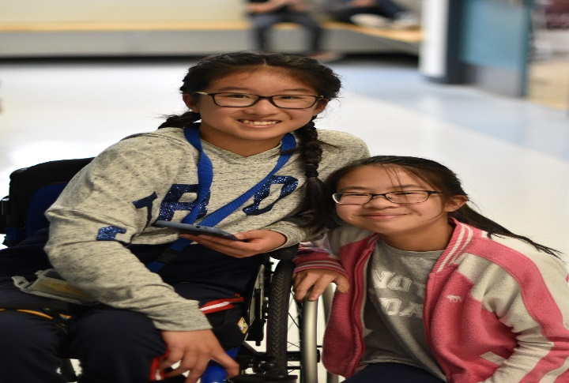
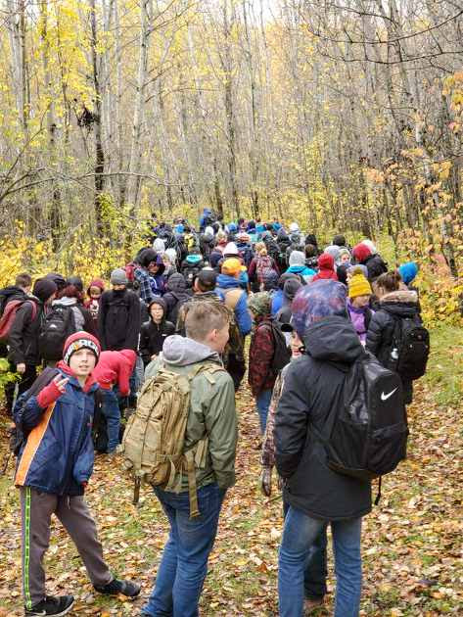
Grade 7 Core classes
French Language Arts, English Language Arts, Reading, Math, Science and Social Studies
Core +
Choose two of the core classes for a booster or challenge program
Activity +
All students take PE and Recreational fitness
Cross country, Volleyball, Pickleball, Basketball, Floor Hockey, Ringette, Handball, Badminton,
Track and Field, Ping Pong, Walks, Tobogganing, Soccer, Softball, Football, Ultimate Frisbee,
Games, Fitness gym workouts, Yoga and so much more

Slide 11
Grade 7 Program at a Glance

Slide 12
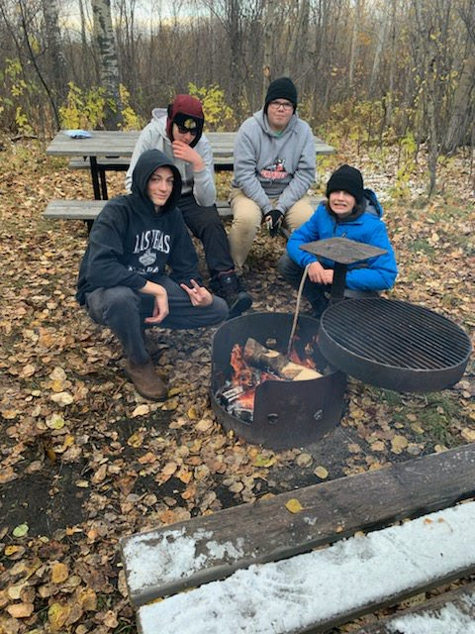
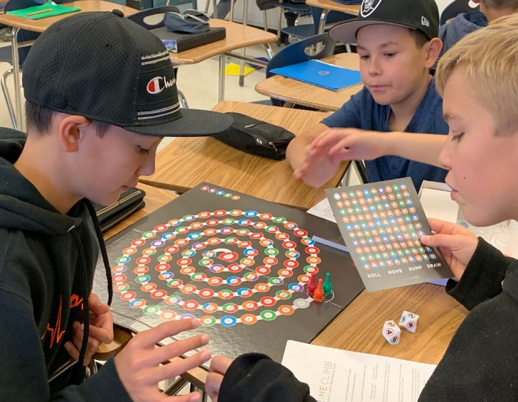
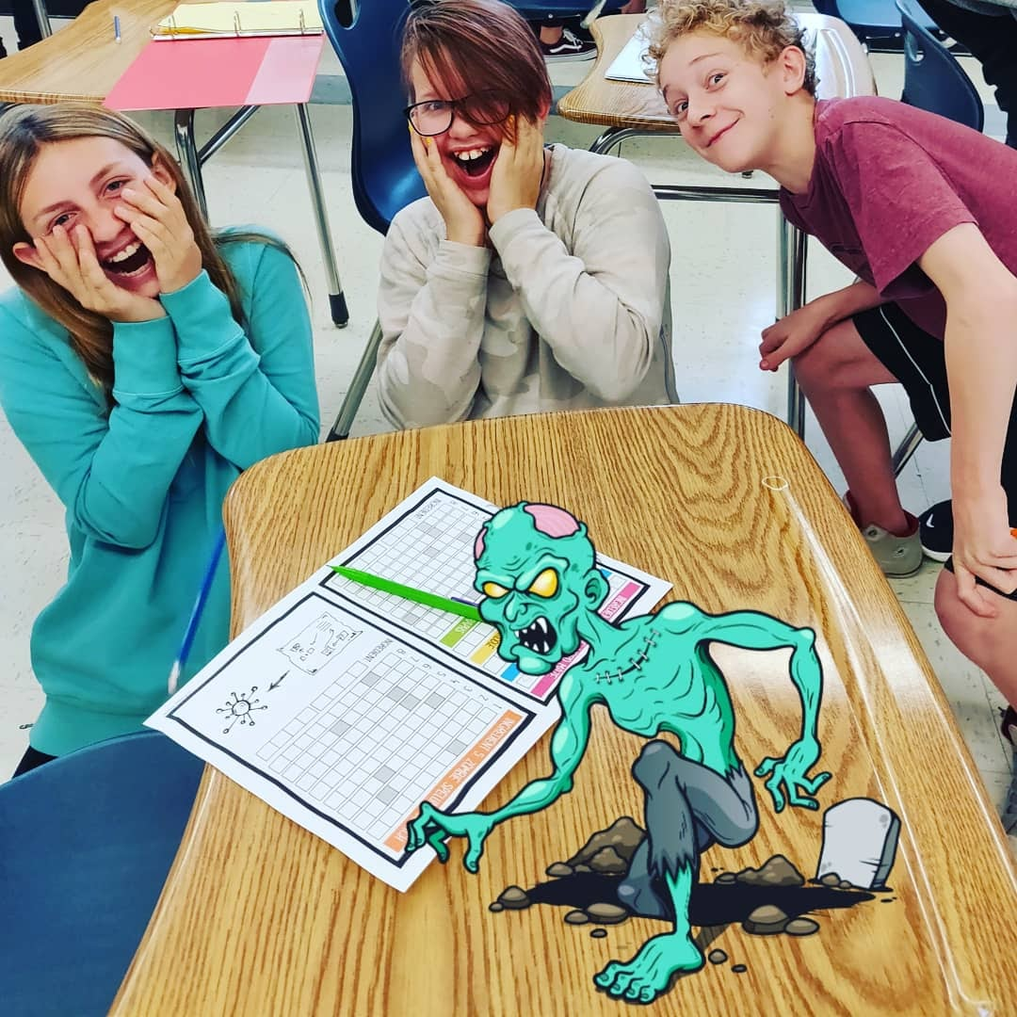
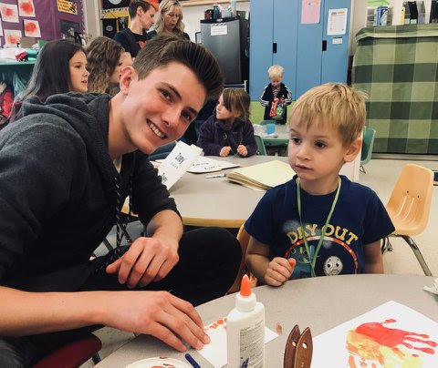
Complementary (Option) Courses
Art, Band, Drama, Outdoor Education, French as a Second Language
Career Technology Foundations (CTF)
Digital Media, Applications of Technology, Electronic Music
Construction, Lego Robotics,
Food Studies, Fashion Studies, Culinary Tourism
Leadership, Learning Strategies, Independent Study

Slide 13

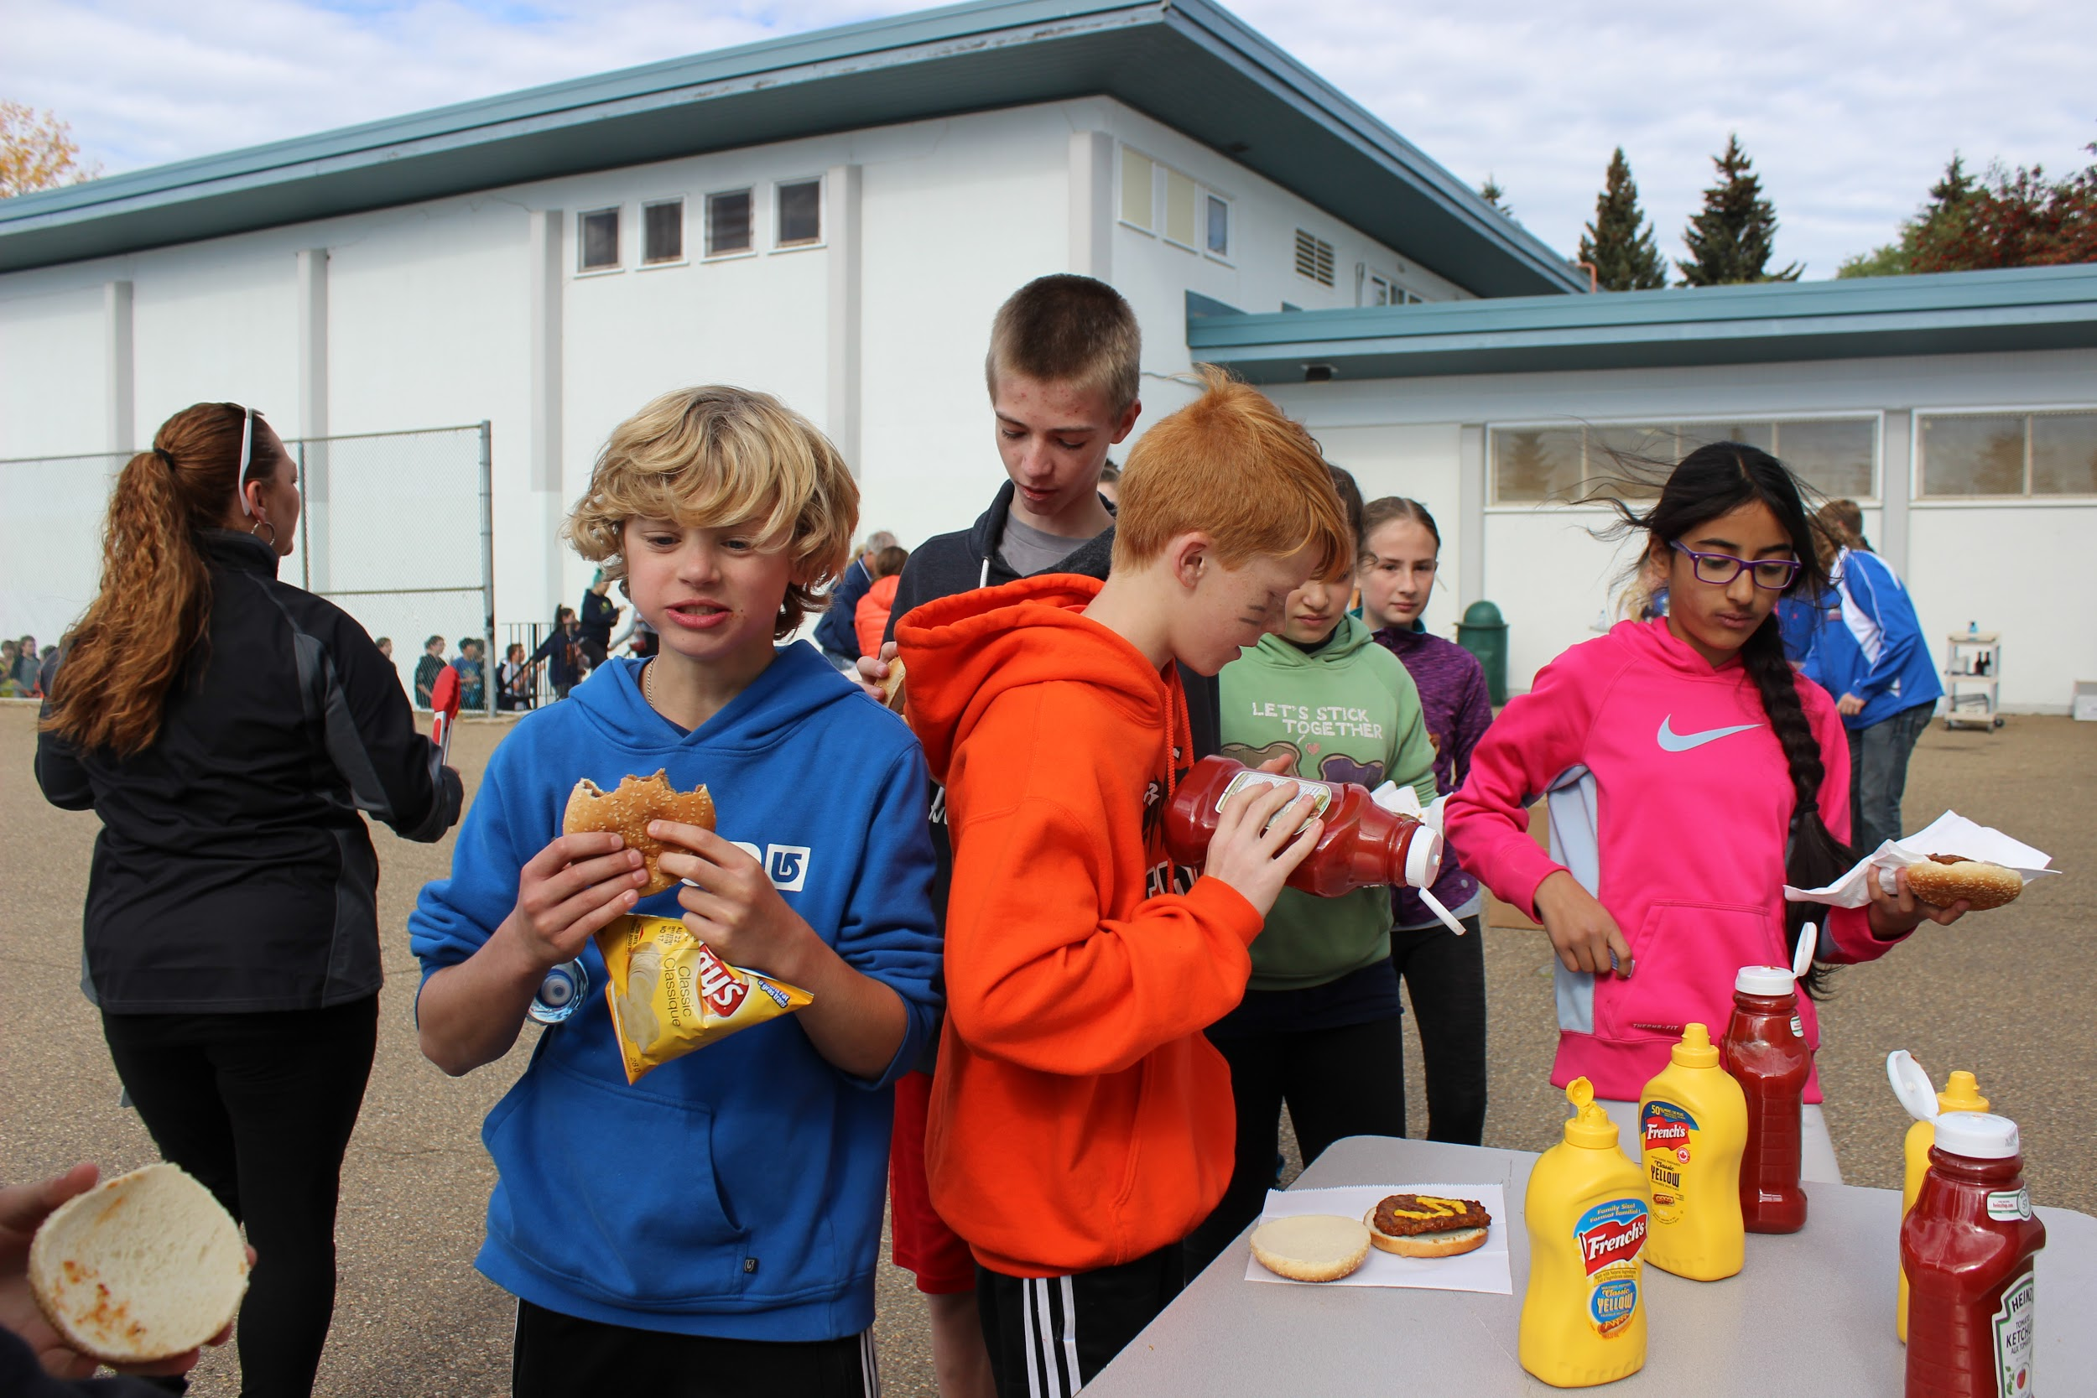
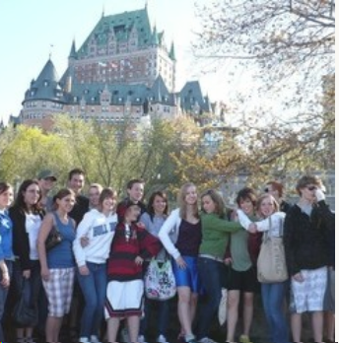
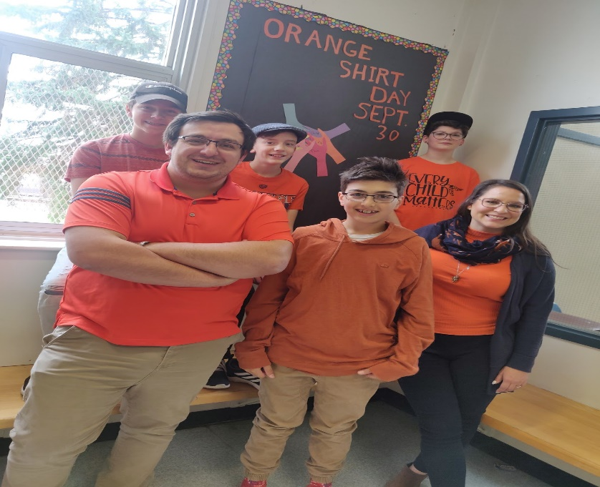
Events
Week of Welcome Cougar Run Orange Shirt Day
Awards night Halloween Dances
Mental Health week Intramurals Band Trips
French Unique Events
Working with Petite Soleils – French Immersion day care
Quebec Trip, Unitheatre, Flying Canoe

Slide 14
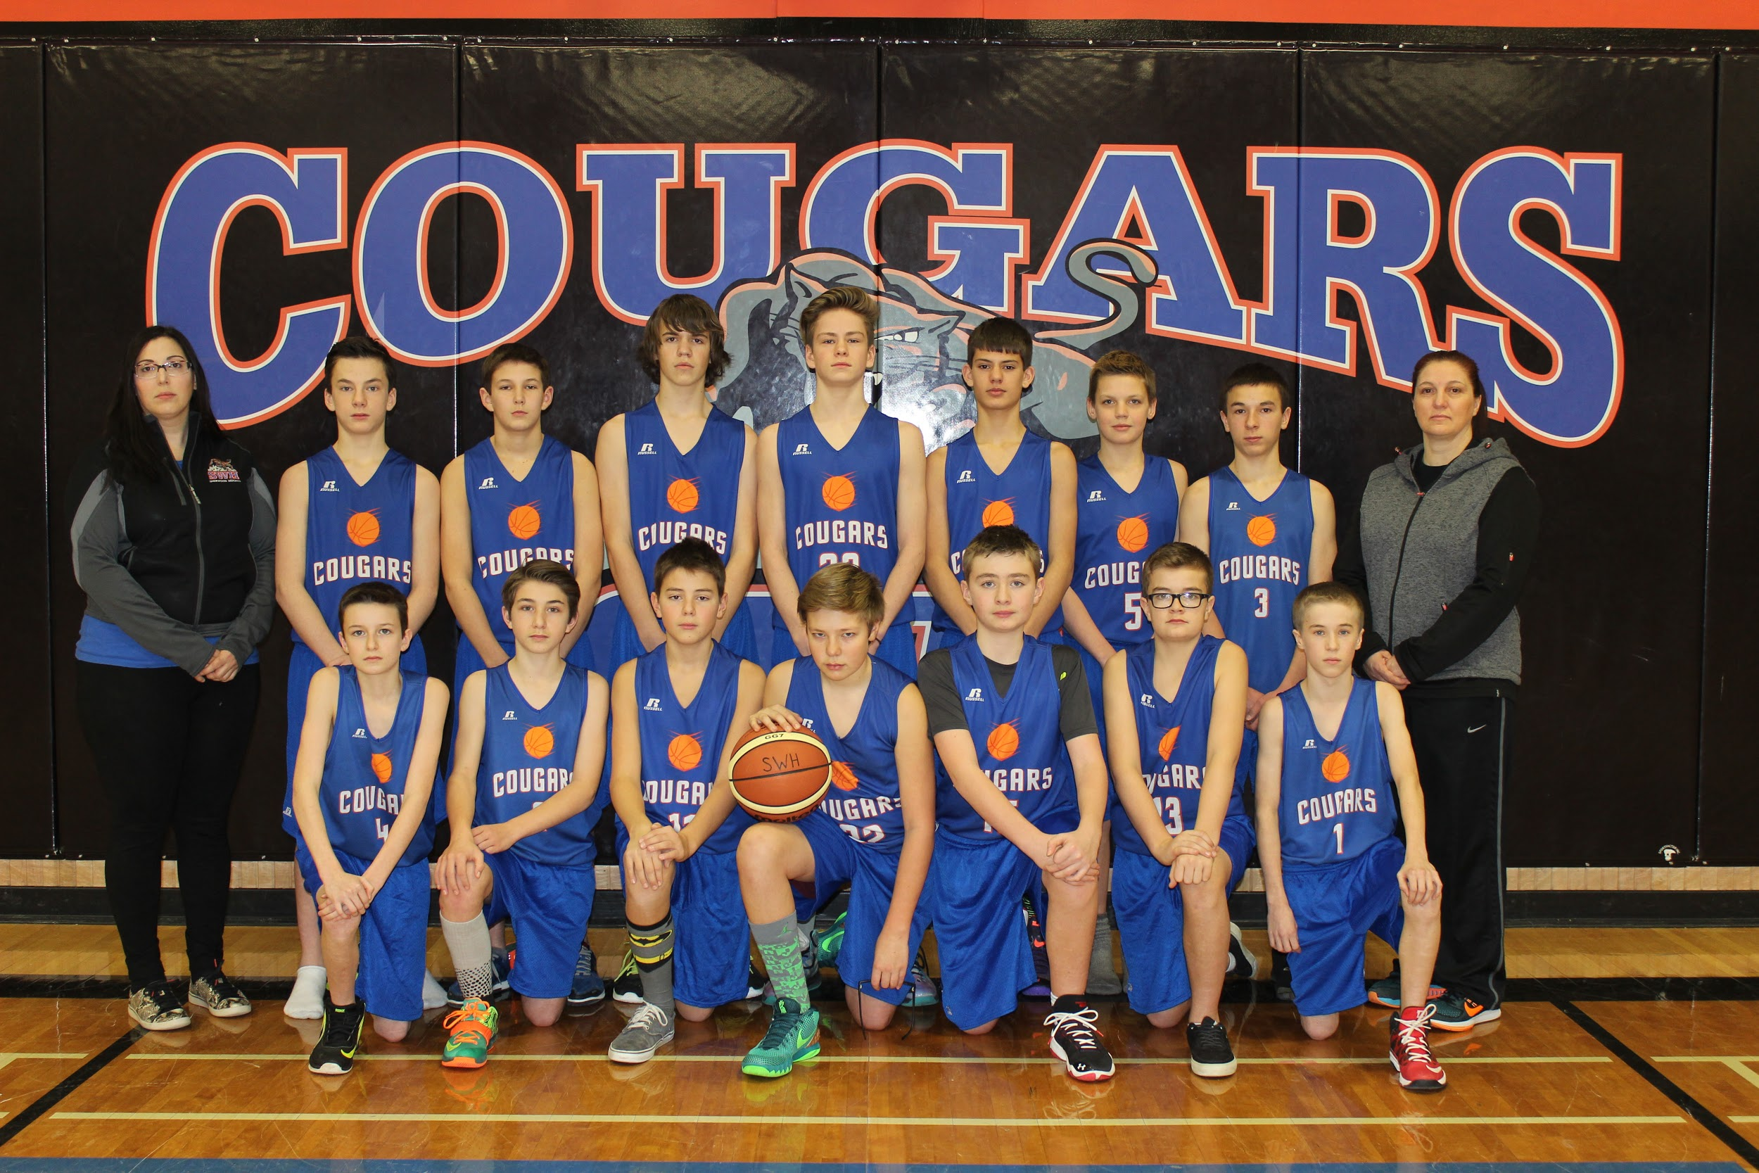
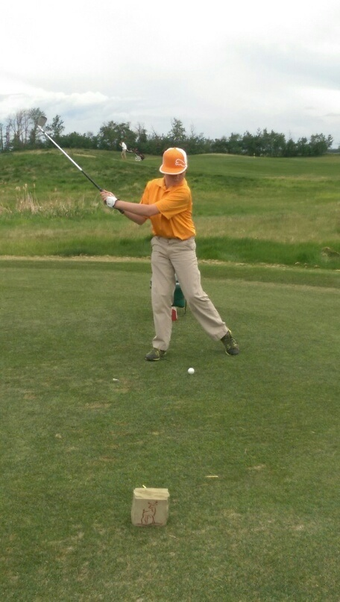
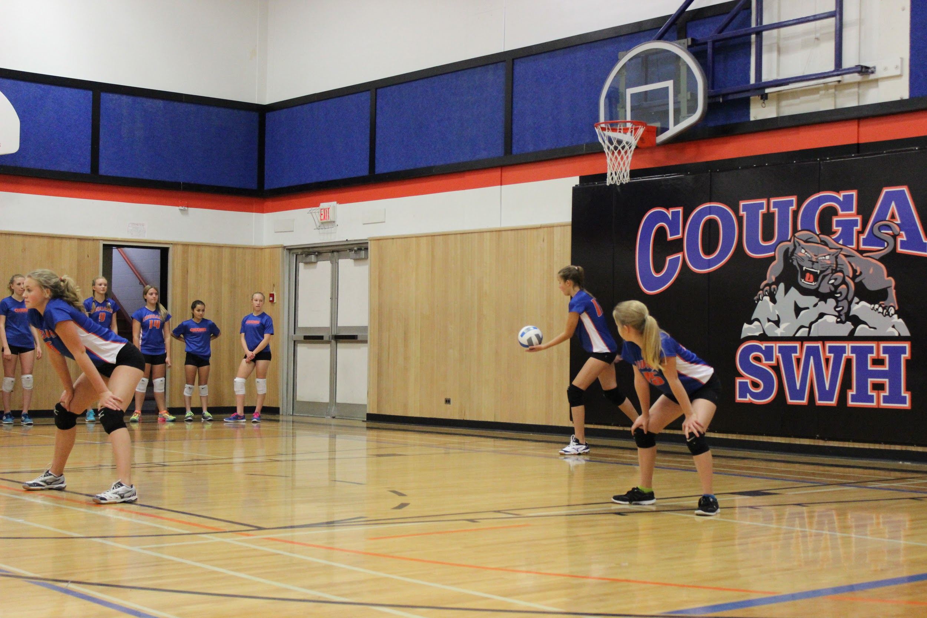
Athletics Opportunities
Senior, Junior and Developmental teams in Volleyball and Basketball
Cross Country, Handball, Badminton, Track and Field, Ultimate Frisbee, Golf, Cheer

Slide 15
Student speakers Emma Smith and David Walsh
Life as a French Immersion student at Sherwood Heights

Slide 16
High School French Immersion Programming in Elk Island Public Schools
Ardrossan Jr. Sr. High School offers our French Immersion (FI) Programming for Grades 10 through 12. Along with the junior high program, we offer the high school programming needs for Elk Island Public Schools.

Slide 17
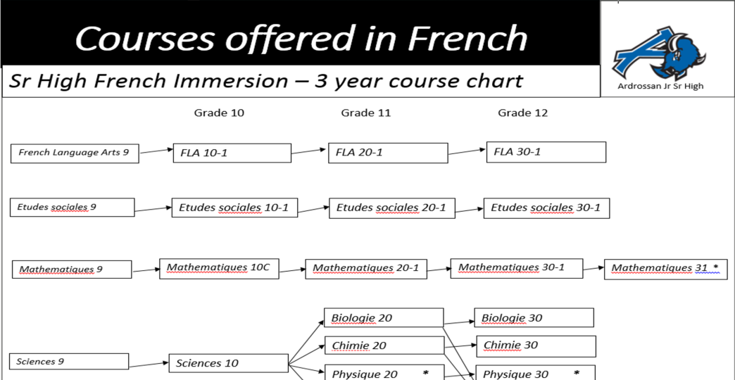
I completed Junior High in French, where do I go now?
Here are the courses you will need to take:

Slide 18
French Language Arts 10, 20, 30 Etudes Sociales (Social Studies) 10, 20, 30 Sciences – Sciences 10, Biologie 20 et 30, Chimie 20 et 30 Les Maths 10, 20, 30

Slide 19
Find your own door and your own path
Talk to your teachers and counsellors
Look at the websites of the post-secondary institutions that interest you
Take full advantage of the tools offered to you such as the tools offered in your CALM class

Slide 20
Student 1
Hi, my name is Samuel and I'm currently enrolled in the French immersion program at Ardrossan Junior-Senior High School. Throughout my time in French immersion, I've wanted to do many different things as a career. In elementary I wanted to be a racecar driver, then an astronaut, then in junior high, I wanted to be a pilot, and now, a politician. One thing that's stayed consistent between all these careers, is the importance of french. The most important race in F1 is held in Le Mans, France. Astronauts deal with every other county that has a space program. France has the largest space program in Europe and the third oldest in the world. To know French in the aviation industry in Canada is extremely useful, as you can get more important flights which get you higher pay. Finally, knowing french makes being a politician much much easier as you don't need a translator and you can better deal with problems of the French minority outside of Quebec. French is a very important skill and I'm very glad I decided to stick with it. Whatever industry I decide to go into, I know I'll have a leg up on the other candidates because most of them can't say they know both of Canada's official languages.
Notes:
Hannah Bayne

Slide 21
French Immersion Program
Since our program is like a small school within a bigger one, our French Immersion students can take advantage of so many opportunities, like…

Slide 22
Language-Spanish
Fine Arts- Band, Art, Drama
Wide Range of CTS courses:
Communication Technology,
Construction Technology,
Esthetician,
Fabrication Studies,
Foods and Commercial Foods
Mechanics

Slide 23
Les arts
Arts
Band
Drama
A.d.c.- Ardrossan Drama Company
Notes:
Largest band in EIPS- Festivals- Trips to Whistler, Banff and this year Toronto – Niagara Falls

Slide 24
Physical Education
Conditionnement physique (Personal Fitness)
Sports Performance
Cross Fit

Slide 25
Les Sports
X-Country
Volleyball
Basketball
Badminton
Handball
Track and Field
Archery
Cheer (Jr. And Sr. High)
Soccer(High School)
Football(High School)

Slide 26
Continue in French Immersion!
Aside from enhancing his or her French, a student in French Immersion, after successfully completing grade 12, will receive a Bilingual Certificate from Elk Island Public School Board.
Here are the criteria:

Slide 27
French Immersion Certificate
Elk Island will award a French Immersion Certificate to students who:
Complete at least 2 French courses (one of which must be FLA) to the 30 level
At least 30 total credits in French Immersion (6 Courses) over the three years in high school.
- French Language Arts - Études Sociales
- Sciences - Biologie
- Mathématiques - Chimie
* Courses offered at the high school level depend on that year’s interest and student body. Over the past few years, Biologie 30 and Chimie 30 have been offered in alternating years.

Slide 28
Once in French Language Arts 30 Students will have the opportunity to write the DELF exam at the B2 level.
What is the DELF exam?
Le Diplome d’etudes de langue francaise (DELF) is an international diploma officially awarded by the French Ministry of Education to certify the French language skills of candidates from outside France.
The certification is good for life!
At this level, the student has a degree of fluency and spontaneity in interactions and is capable of correcting his/her own mistakes.

Slide 29


Slide 30
Students may take the DELF……….
To be assessed with the same international language standards as candidates in 173 countries
To continue studies at a French university
To complement language education with a universally recognized diploma

Slide 31
Student 2
Hello, My name is Bryanna Kephart. I am a grade twelve student in the french immersion program at Ardrossan Jr. Sr. High. I’ve been in french immersion since preschool and like most of you, my parents came to this meeting and thought about how french would affect my future. I can honestly say that it’s one of the best decisions my parents made for me. French immersion is so special in the way that it opens your eyes to new perspectives and expands your field of knowledge, and to be able to do this all throughout school is amazing.
First of all, there are so many academic assets of being in french immersion; from the courses themselves, to the DELF test, to university. Our school provides the DELF test in grade twelve, which is an international french competency test. All throughout junior high and high school our teachers are preparing us for this test so that we can go into it confidently and pass it without any problem. This certification is important because we get to do it in school, which isn’t the case in all schools, and we can use it in university and job applications. In addition to the DELF test, we had our awesome Quebec trip in grade nine, where I learned so much about the places we had studied in our textbooks and it brought a whole new level of understanding to what we were learning in school. That being said, I also made some great memories and it was a small taste of independence.
Furthermore, French has brought me a lot of places in my personal life. I got the opportunity to go on a french immersion trip this summer where I met people from all over the world, to live on a university campus for a month and learn more about french and the rich culture that goes along with it. I treasure the friendships that I made there. Noce of that would have been possible without the french immersion program at school.
Which brings me to my next point, we are so interconnected these days that it’s important to be able to communicate effectively with a vast group of people. The more languages you know, the better equipped you are to talk to people from all over. This is as much of a personal bonus as it is a bonus in any career. French helps you not only talk to people in the community better, but also travel better and learn more languages which, in turn, advance you further.
French has given me incredible opportunities over the years and I’m positive that it will continue to do so throughout the rest of my life.
Notes:
Danika Oystrek

Slide 32
Do you still need another reason?

Slide 33
French Immersion, a tool to enhance your English and for post secondary and beyond

Slide 34


Slide 35
What do we do at Elk Island Public Schools to ensure success for our French Immersion students?
We maintain contact with parents through Powerschool, email, meetings and phone calls.
Teachers discuss regularly the progress of the French Immersion students.
Excellent teachers and staff

Slide 36
Awards and beyond……
During our 2018 awards night, 40% of awards were given out to French Immersion Ardrossan students.
Graduates of Elk Island Public School`s French Immersion program have gone on to be successful in Engineering at the U of A, Sports Psychology at the U of A, Computer Sciences Degree and employed at EA Games, Medical Laboratory Sciences, Campus St. Jean and many more.

Slide 37
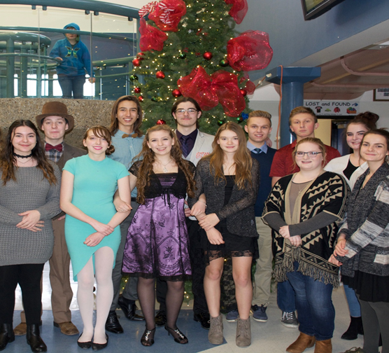
Student Council and our Grade 12 students in French Immersion
Leadership
Volunteerism
Community

Slide 38
The Ardrossan French Immersion Program is proud of: We offer the following courses in French. French Language Arts, Biology, Chemistry, Social Studies, Math at all levels as well as Science 10. Great retention rate from Jr. High to Sr. High year after year Great rapport and relationship with each class/grade year after year Strong results and performance on provincial achievement tests (Grade 9) and diploma exams Grade 12) yearly Strong rate of participation from French Immersion students and success in sports, band, drama, exchanges, etc. Maintains a strong enrollment since beginning in 1989-90 Many graduates continue on to Campus Saint Jean University of Alberta (French University program) Strong local Canadian Parents for French chapter (Ardrossan) that supports our program Possibilities for exchange programs to Québec and France

Slide 39
Campus St. Jean
Notes:
Tamia - Bursary

Slide 40
Final Thought
Sherwood Heights Junior High and Ardrossan Junior Senior High are both offering you the opportunity to enhance your French skills through core subjects. Why not embrace it? You have already invested 7 to 10 years after all…
A l’an prochain!

Slide 41
Pre-enrollment process
February 1 to 28, 2020
Online
Once registered, our counsellors will visit each school to assist with the registration process.

Slide 42
Questions…..
Mr. Paul Pallister (Principal, Sherwood Heights)
E-mail: Paul.Pallister@eips.ca
MJ Nam (Principal, Ardrossan Junior Senior High School)
E-mail: MJ.Nam@eips.ca
Annie Garneau, EIPS French Immersion Consultant
E-mail: Annie.Garneau@eips.ca

