Slide 1


Elk Island Public Schools
SECONDARY FRENCH IMMERSION
Information Night

Slide 2

Le 20 janvier 2021
Bienvenue et bonsoir!
Notes:
Land and People Acknowledgement
We acknowledge with respect the history and culture of the peoples with whom Treaty 6 was signed and the land upon which Elk Island Public Schools reside. We also acknowledge the traditional homeland of the Métis Nation.
We recognize our responsibility as Treaty members and honour the heritage and gifts of the First Peoples.
We commit to moving forward in partnership with Indigenous communities in a spirit of collaboration and reconciliation

Slide 3
Administration
Mme MJ Nam, Principal, Ardrossan Jr. Sr. High School
Mme Annie Garneau, EIPS French Immersion Consultant and Assistant Principal, École Campbelltown
Mme Tandy Atchison, EIPS French Immersion Consultant and Assistant Principal, École Parc

Slide 4
Who should consider the EIPS French Immersion Secondary program
Our current grades 6 and 9 French Immersion students can continue their investment in their learning.
Students wanting to continue to enhance their French skills through French Language instruction.

Slide 5
French Immersion Junior High within Elk Island Public Schools
Ardrossan offers a French Immersion (FI) Program for Grades 7 to 9.
Students currently enrolled in an elementary program are designated to one of two schools for junior high.
The program includes French Language Arts, Science, Social Studies, Math and English Language Arts.
Students in the FI Program can take advantage of cultural activities and exchanges, important educational aspects of the program.

Slide 6
Schedule…what does that mean?
Different teachers and different
classrooms for different subjects.

Slide 7
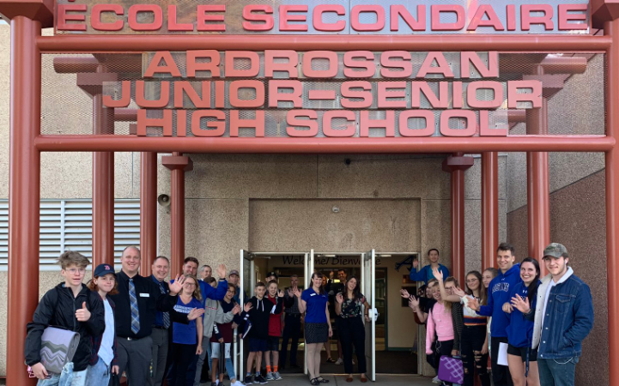

Slide 8
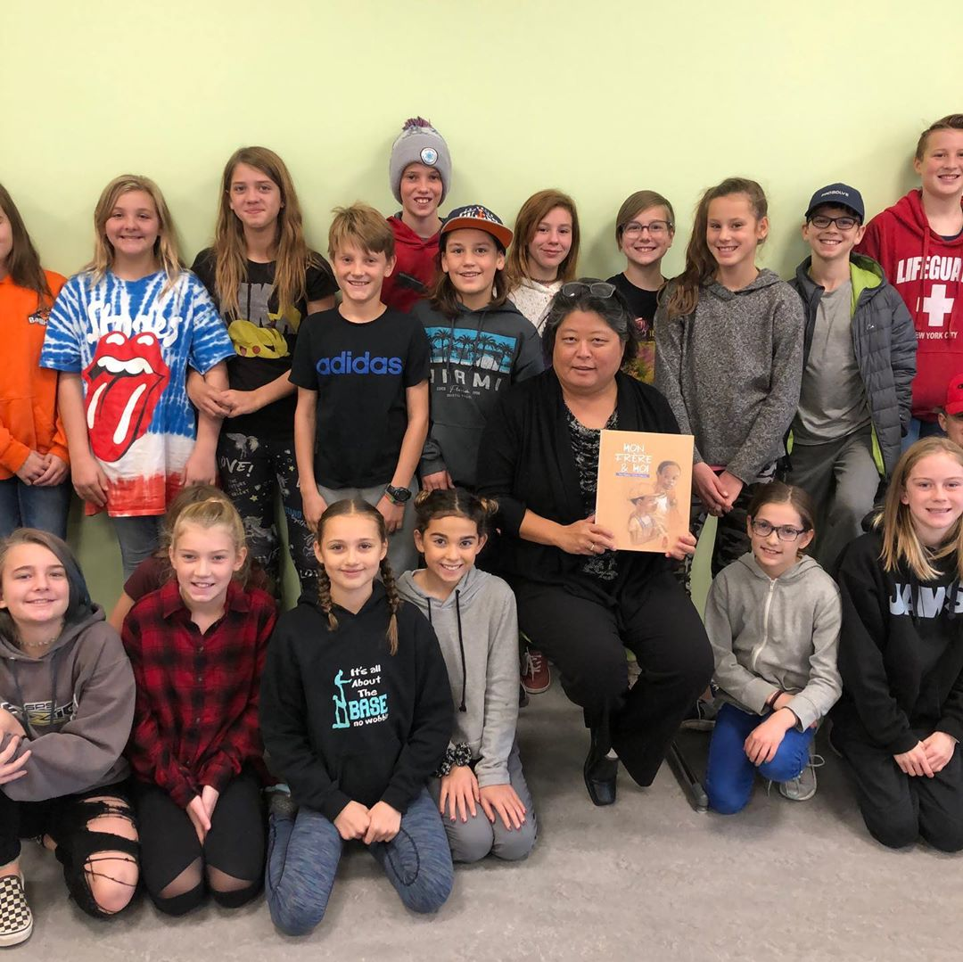
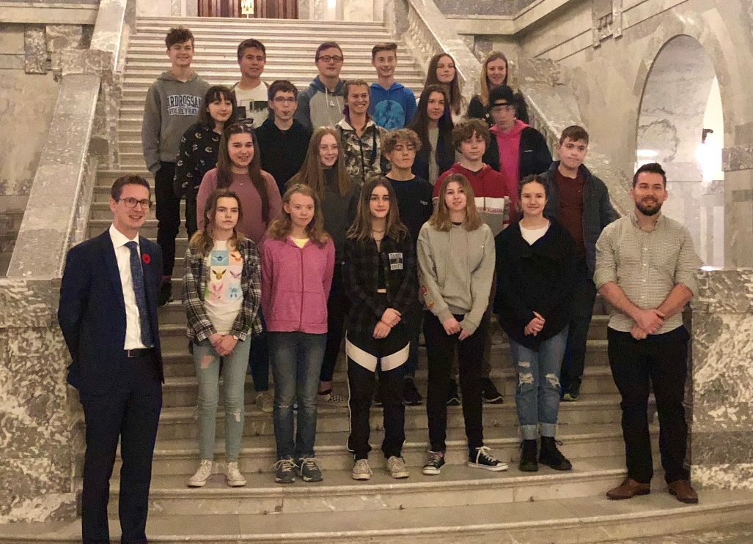
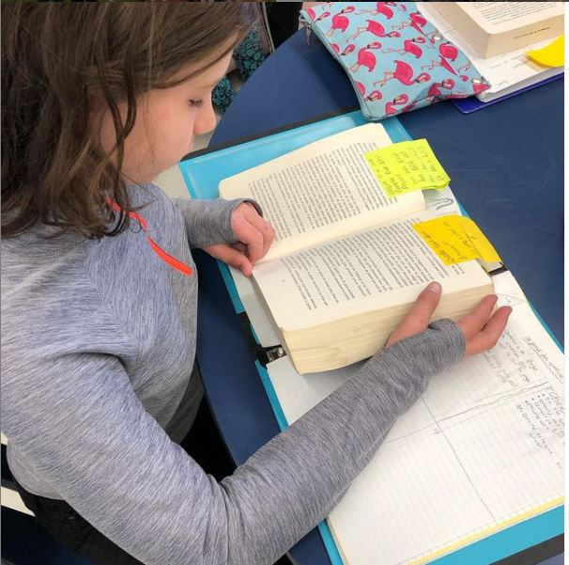
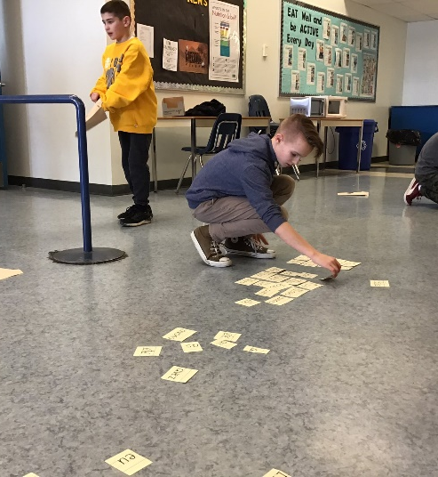
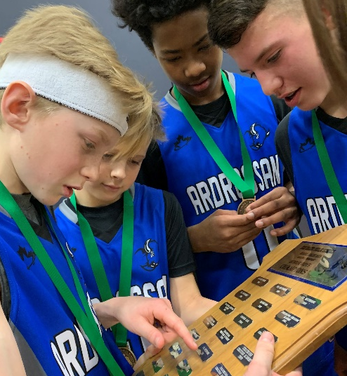
School Life

Slide 9
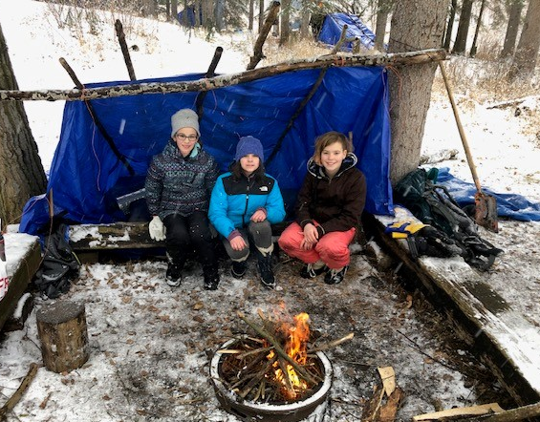
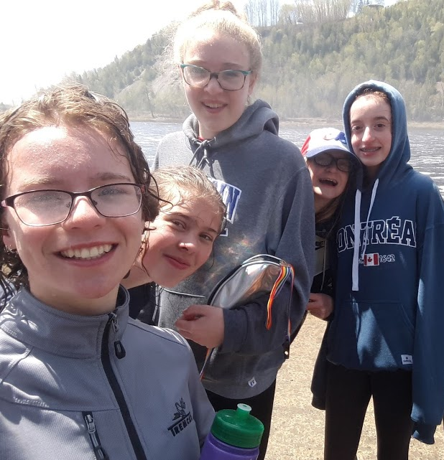
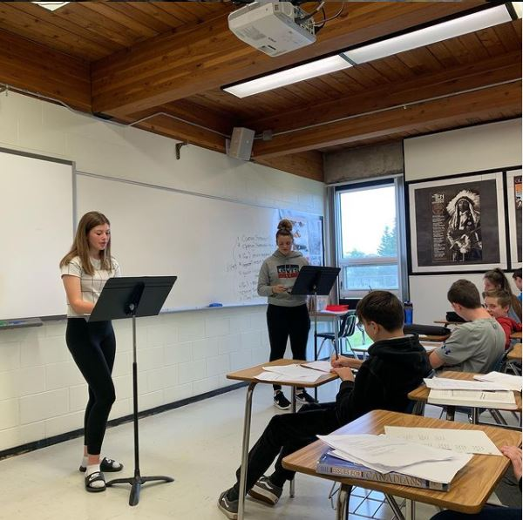
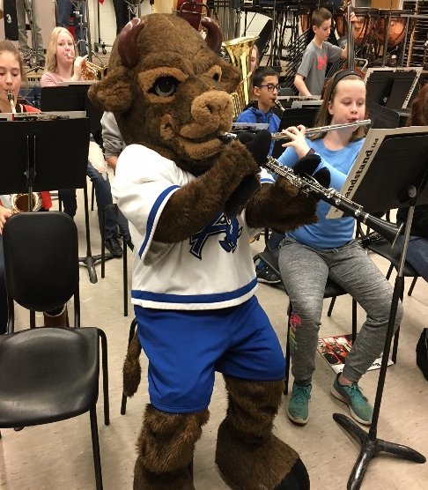
School Life

Slide 10
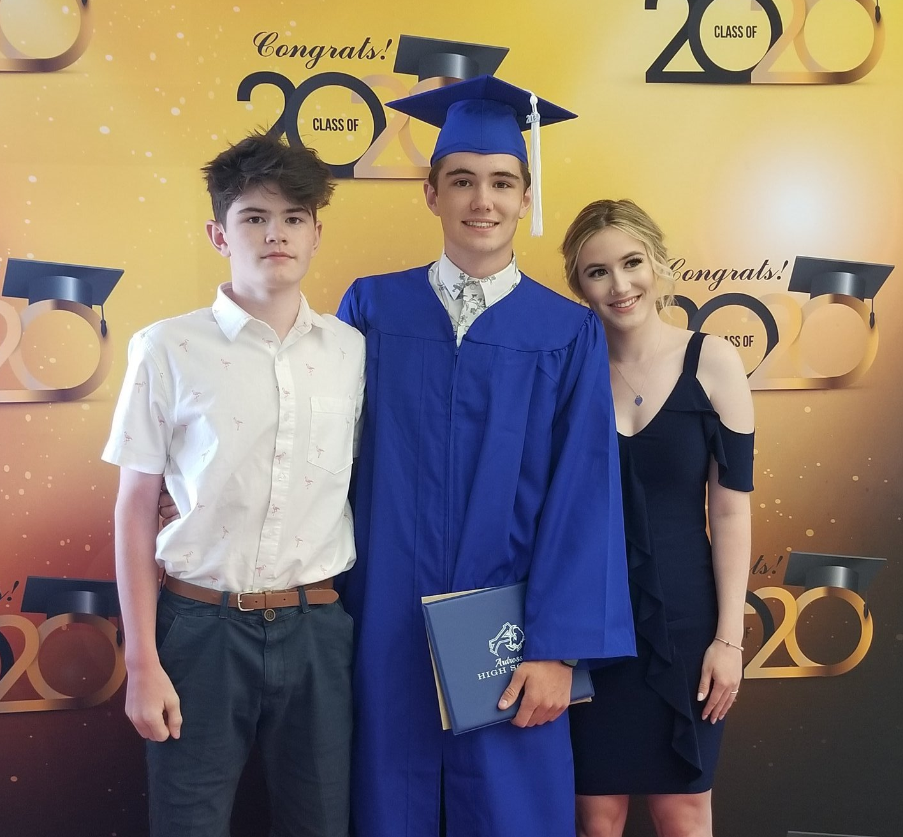
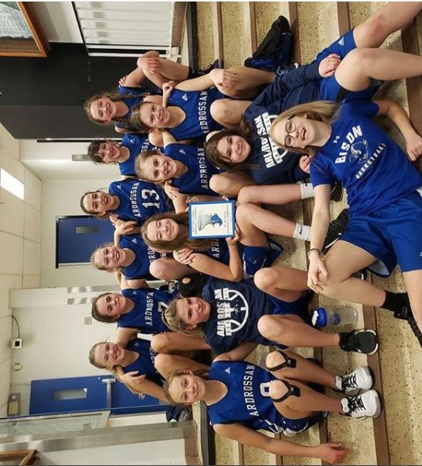
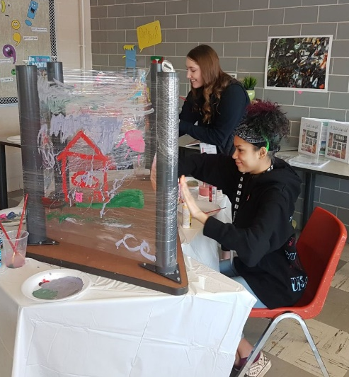
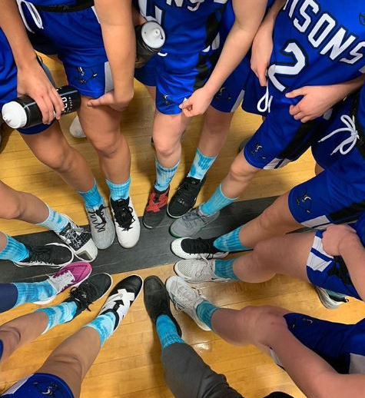
School Life

Slide 11
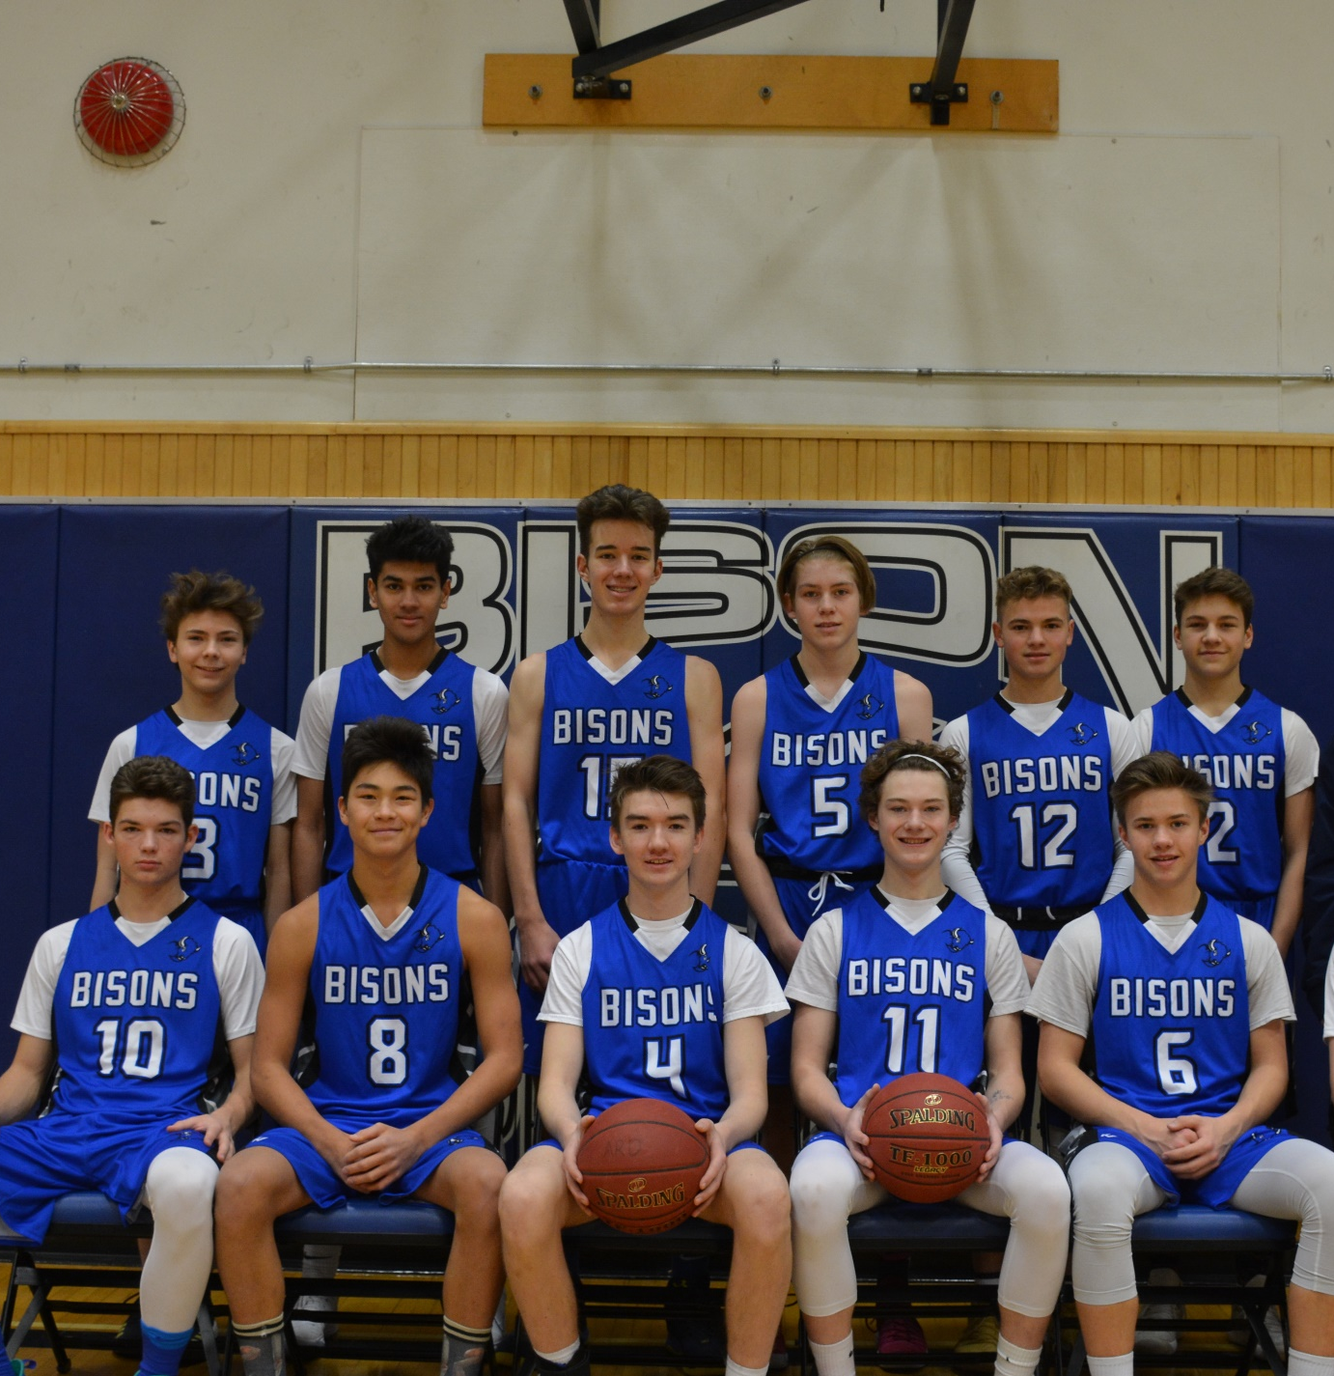
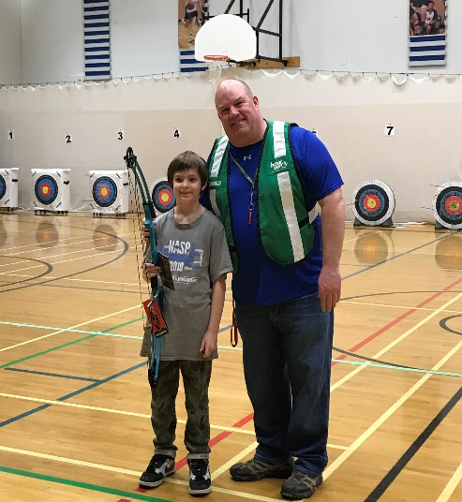
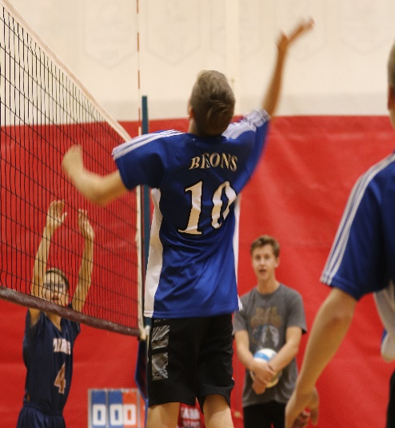
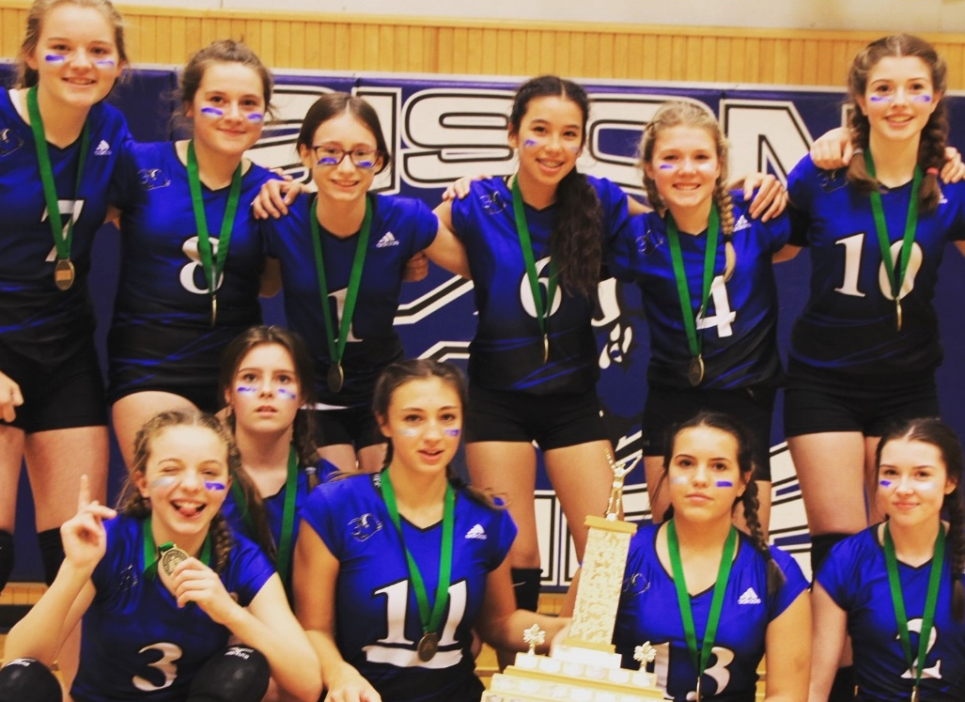
School Life

Slide 12
At the end of grade 9, you will have completed:
Etudes sociales 9;
(Social Studies 9)
Mathématiques 9;
(Mathematics 9)
Sciences 9;
(Science 9)
English Language Arts 9
(ELA 9)
French Language Arts 9
(FLA 9)
Physical Education 9 and your options

Slide 13
High School French Immersion Programming in Elk Island Public Schools
Ardrossan Jr. Sr. High School offers French Immersion (FI) Programming for Grades 10 to 12.
Along with the junior high program, we offer the high school programming needs for Elk Island Public Schools.

Slide 14
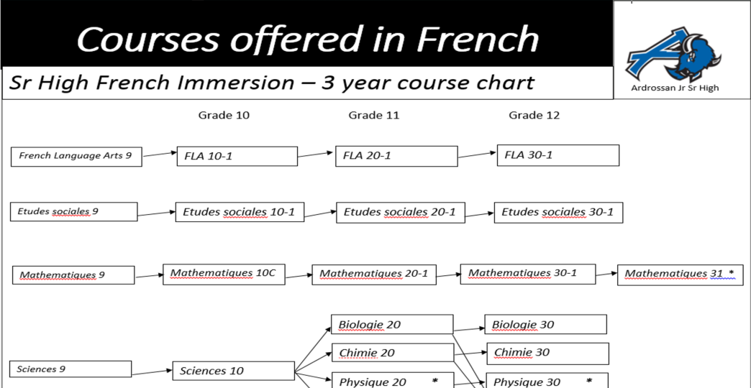
Here are the courses you will need to take:

Slide 15
French Language Arts 10, 20, 30
Etudes Sociales (Social Studies)
10, 20, 30
Sciences – Sciences 10, Biologie 20 et 30, Chimie 20 et 30
Les Maths 10, 20, 30

Slide 16
Find your own door and your own path
Talk to your teachers and counsellors.
Look at the websites of the post-secondary institutions that interest you.
Take full advantage of the tools offered to you such as the tools offered in your CALM class.

Slide 17
Student 1
Hi, my name is Samuel and I'm currently enrolled in the French immersion program at Ardrossan Junior-Senior High School. Throughout my time in French immersion, I've wanted to do many different things as a career. In elementary I wanted to be a racecar driver, then an astronaut, then in junior high, I wanted to be a pilot, and now, a politician. One thing that's stayed consistent between all these careers, is the importance of French. The most important race in F1 is held in Le Mans, France. Astronauts deal with every other county that has a space program. France has the largest space program in Europe and the third oldest in the world. To know French in the aviation industry in Canada is extremely useful, as you can get more important flights which get you higher pay. Finally, knowing French makes being a politician much easier as you don't need a translator and you can better deal with problems of the French minority outside of Quebec. French is a very important skill and I'm very glad I decided to stick with it. Whatever industry I decide to go into, I know I'll have a leg up on the other candidates because most of them can't say they know both of Canada's official languages.

Slide 18
French Immersion Program
Since our program is like a small school within a bigger one, our French Immersion students can take advantage of so many opportunities such as:

Slide 19
French Immersion Program
Language – Spanish
Fine Arts – Band, Art, Drama
Wide range of CTS courses:
  Communication Technology
  Construction Technology
  Esthetics
  Fabrication Studies
  Foods and Commercial Foods
  Mechanics

Slide 20
Les arts
Arts
Commercial Arts
Band
Drama
Performing Arts
A.d.c. – Ardrossan Drama Company

Slide 21
Physical Education
Conditionnement physique (Personal Fitness)
Sports Performance

Slide 22
Les Sports
X-Country
Volleyball
Basketball
Badminton
Track and Field
Archery
Cheer (Jr. and Sr. High)
Soccer (High School)
Football (High School)

Slide 23
Continue in French Immersion!
Aside from enhancing his or her French, a student in French Immersion, after successfully completing grade 12, will receive a Bilingual Certificate from Elk Island Public School Board.

Slide 24
French Immersion Certificate Critiera
Elk Island will award a French Immersion Certificate to students who:
Complete at least two French courses (one of which must be FLA) to the 30-level
At least 30 total credits in French Immersion (six courses) over the three years in high school.
- French Language Arts - Études Sociales
- Sciences - Biologie
- Mathématiques - Chimie
*Courses offered at the high school level depend on that year’s interest and student body. Over the past few years, Biologie 30 and Chimie 30 have been offered in alternating years.

Slide 25
French Language Arts
Once in French Language Arts 30, students will have the opportunity to write the DELF exam at the B2 level.
What is the DELF exam?
  Le Diplome d’etudes de langue francaise (DELF) is an international diploma officially awarded by the French Ministry of Education to certify the French language skills of candidates from outside France.
The certification is good for life!
At this level, the student has a degree of fluency and spontaneity in interactions and can correct his/her own mistakes.

Slide 26


Slide 27
Students may take the DELF…
To be assessed with the same international language standards as candidates in 173 countries
To continue studies at a French university
To complement language education with a universally recognized diploma

Slide 28
Student 2
I am a grade 12 student here at Ardrossan in the French immersion program. I have been in French since I was put into a francophone preschool. As I got older it became more my choice and less that of my parents. I concluded that continuing my French education would make me much more versatile. Which it does. Being able to communicate in two languages opens many doors. Whether they be having the ability to communicate with a much larger percentage of the population, opening job opportunities or even just being able to learn new languages quicker. French has presented me with opportunities to converse in eastern Canada effortlessly and with some minor difficulty and lots of hand signals in southern America. Learning French for me has been a very good experience, and I hope you get that experience as well. I am going into university for business this upcoming fall. Having French will give me the opportunity in that world that I would not have otherwise. I hope you enjoy Ardrossan.

Slide 29

Do you still need another reason?
French Immersion, a tool to enhance your English and for post-secondary and beyond.

Slide 31
What do we do at Elk Island Public Schools to ensure success for our French Immersion students?
We maintain contact with parents through PowerSchool, email, meetings and phone calls.
Teachers discuss regularly the progress of the French Immersion students.
Excellent teachers and staff.

Slide 32
Awards and Beyond
During our 2019-Awards Celebration, 40 percent of awards were given out to French Immersion Ardrossan students.
Graduates of Elk Island Public School’s French Immersion program have gone on to be successful in Engineering at the U of A, U of Ottawa, Sports Psychology at the U of A, Computer Sciences Degree and employed at EA Games, Medical Laboratory Sciences, Campus St. Jean and many more.

Slide 33
Pre-enrollment Process
February 1 to 28, 2021
Online
Once registered, our counsellors will visit each school to assist with the registration process.

Slide 34
Common Questions
As a parent, how will I help my child if I do not speak French?
Ardrossan Junior Senior High is a large school; will my child know anyone?
What will be my child’s workload should he/she remain in the program?
  The overall workload in grade 7 is greater than in elementary, regardless of your child’s program.
  The schedule rotates on a Day 1/Day 2 basis and students should prepare for approximately a half-hour to an hour of homework per night.

Slide 35
Common Questions
What will happen after grade 9?
  Students continue with high school courses as normal. Some FI students are integrated into English classes depending on their interest levels and possible scheduling conflicts.
I don’t speak French, so how can I help my child when he/she has questions?
  With increased use of technology, new platforms (such as Brightspace allow for better communication between teaching staff, students and parents.
  Our staff work together to provide assistance before and after school and during lunch to aid students.
  At times, additional practice material does go home in English (March Madness math packs) to allow parents or tutors to help students further develop skillsets in areas of weakness.

Slide 36
Common Questions
  Is it harder in French? Is the content more difficult?
    The content is the same regardless of the language of instruction. No, student’s grades do not change should a student transfer into an English program.
  Will my child be disadvantaged or struggle in high school?
    French Immersion students remain among the top students, even when in classes with their English peers. Issues pertaining to new vocabulary, for example, are resolved quickly as FI students have developed problem solving skills over the course of the first nine years.

Slide 37
Remember
Help doesn’t have to take place in the target language. Asking your child to explain what he/she has read, questioning fractions while doubling a recipe, and encouraging written work that has rich vocabulary and proper grammar are skills that transfer between languages and have huge impacts on a student’s success and confidence.

Slide 38
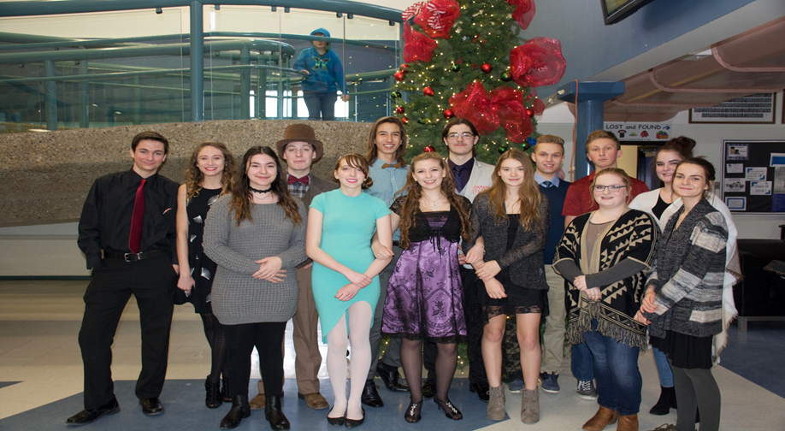
Student Council and our Grade 12 students in French Immersion
Leadership
Volunteerism
Community

Slide 39
We are most proud of:
  We offer the following courses in French - French Language Arts, Biology, Chemistry, Social Studies, Math at all levels as well as Science 10.
  Great retention rate from Jr. High to Sr. High year after year
  Great rapport and relationship with each class/grade year after year
  Strong results and performance on provincial achievement tests (Grade 9) and diploma exams Grade 12) yearly

Slide 40
We are most proud of:
  Strong rate of participation from French Immersion students and success in sports, band, drama, exchanges, etc.
  Maintaining a strong enrollment since beginning in 1989-90
  Many graduates continue on to Campus Saint Jean University of Alberta (French University program)
  Strong local Canadian Parents for French chapter (Ardrossan) that supports our program
  Possibilities for exchange programs to Québec and France

Slide 41
Campus St. Jean
Discover ten reasons why you should choose the University of Alberta's Campus Saint-Jean for your studies:
  Learn in French in Greater Western Canada.
  Enjoy a diversified program of bursaries and grants.
  Take full advantage of numerous international exchange training possibilities.
  Explore the richness of inclusive and cultural diversity.
  Access tailored courses thanks to customized supervision.
  Benefit from the use of the latest technology.
  Learn or improve another language.
  Live a full, stimulating and enriching student life among 1000 students.
  Develop your skills thanks to a wide variety of complementary programs.
  Launch yourself into a career thanks to your leadership skills acquired along with a prestigious degree from the University of Alberta.

Slide 42
Campus St. Jean
Campus Saint-Jean offers Bachelor programs in a wide realm of disciplines. With programs in the Arts, Commerce, and Education, to the Sciences, and specialized programs in Nursing, Engineering, and Environmental Conservation Sciences, you can explore and customize your education to fit your areas of interest and study.
Satellite Campus- BEd
Bachelor of Education- Secondary route
Bachelor of Education - Elementary route
Education/Science Combined Degrees
Bachelor of Education - After Degree
Bachelor of Science
Bachelor of Arts
Bilingual Bachelor of Commerce
Bilingual Bachelor of Science in Nursing
Engineering (First year)

Slide 43
Campus St. Jean
CSJ's unique academic training also offers:
A stimulating research environment for all students with a passion for their field of study - in French;
An advantageous introduction to the entire world;
Personalized instruction to ensure the student is actively involved in their training;
Staff and professors adept at stimulating class participation.

Slide 44
Campus St. Jean
BEFORE APPLYING TO THE PROGRAM
Contact our team of Public Relations Coordinators to answer any questions you may have:
Book a virtual advising session: uab.ca/advising
Via Email: recrutement@csj.ualberta.ca
Or give us a call :
Cristiana Pop
Tel: 780-465-8762
Dany Bazira
Tel: 780-485-8638

Slide 45
Final Thought
  We offer students the opportunity to enhance their French skills through core subjects. Why not embrace it? You have already invested 7 to 10 years after all…
  A l’an prochain!

Slide 46
Questions
MJ Nam, Principal, Ardrossan Junior Senior High School)
E-mail: MJ.Nam@eips.ca
Annie Garneau, EIPS French Immersion Consultant
E-mail: Annie.Garneau@eips.ca
Tandy Atchison, EIPS French Immersion Consultant
E-mail: Tandy.Atchison@eips.ca

