Slide 1
Ardrossan Jr/Sr High School Open House 2021

Slide 2
Ardrossan Jr/Sr High School
Welcome
Bienvenue et bonsoir!
Notes:
Land and People Acknowledgement
We acknowledge with respect the history and culture of the peoples with whom Treaty 6 was signed and the land upon which Elk Island Public Schools reside. We also acknowledge the traditional homeland of the Métis Nation.
We recognize our responsibility as Treaty members and honour the heritage and gifts of the First Peoples.
We commit to moving forward in partnership with Indigenous communities in a spirit of collaboration and reconciliation

Slide 3
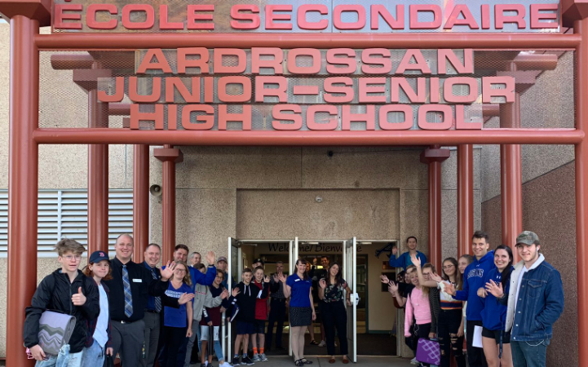

Slide 4
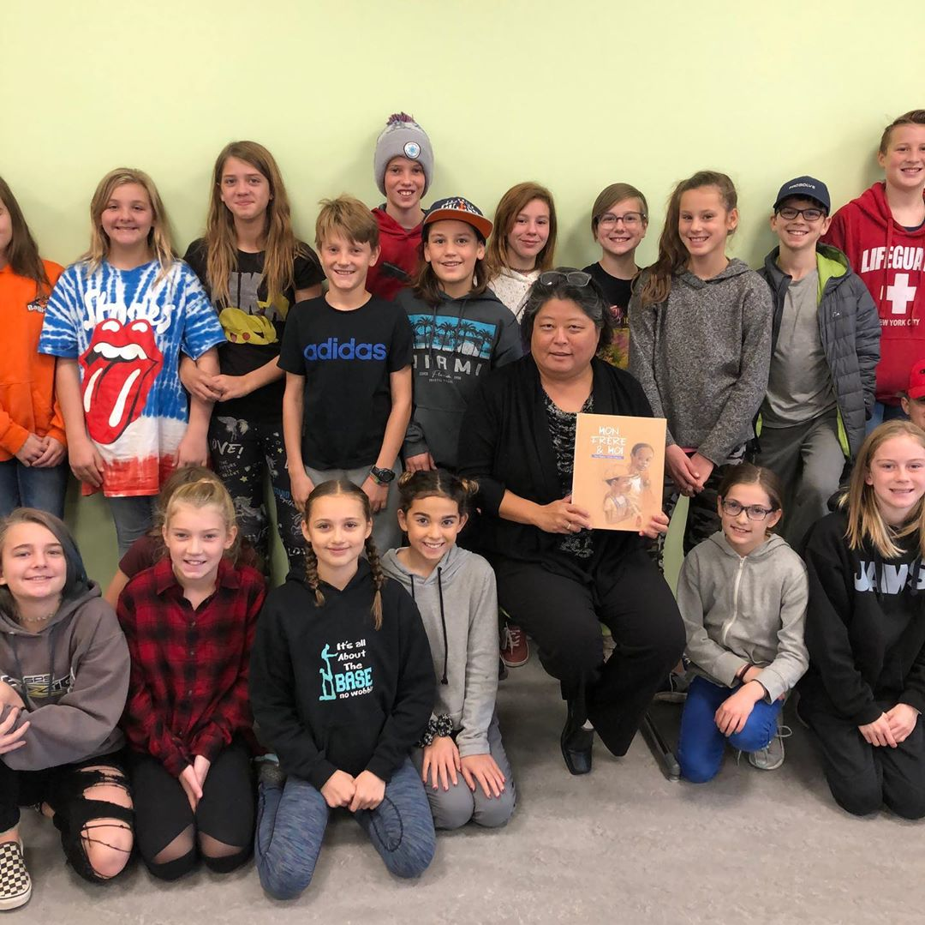
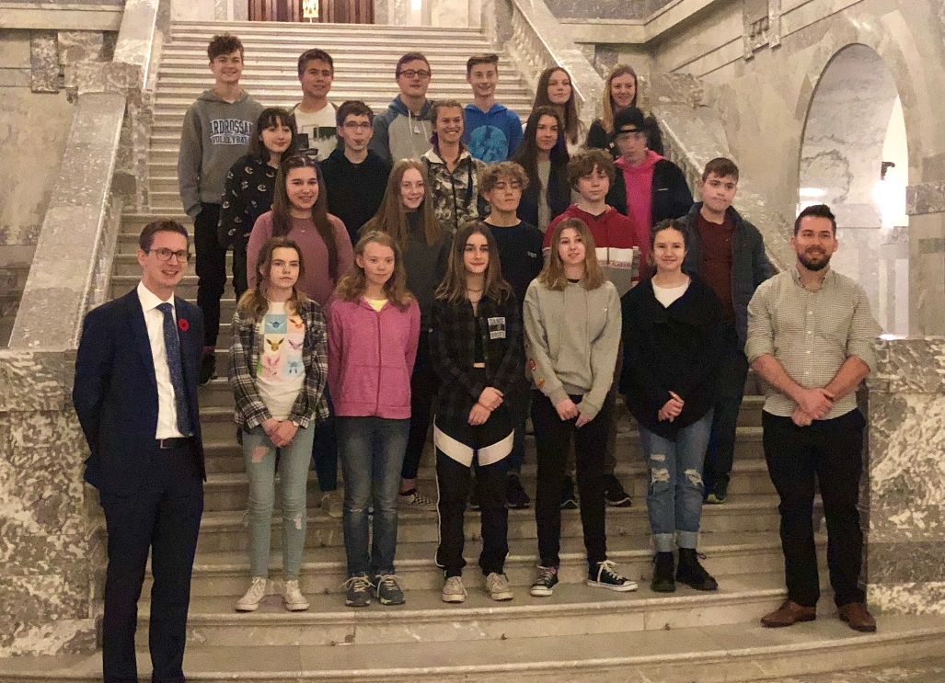
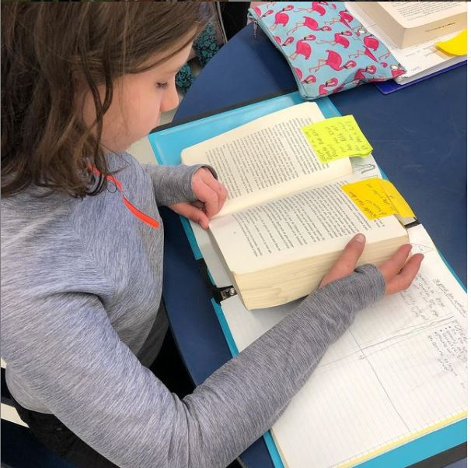
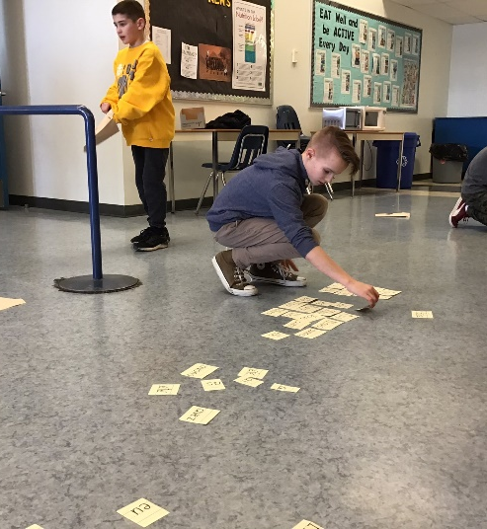
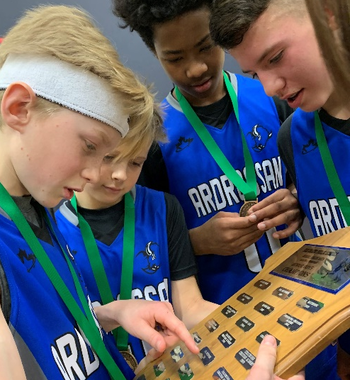
School Life

Slide 5
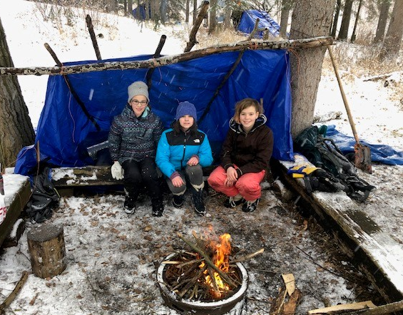
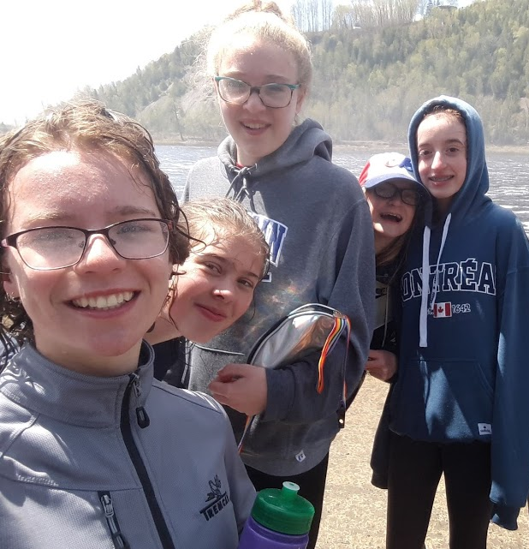
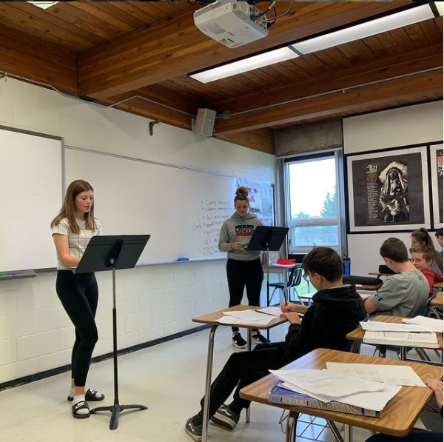
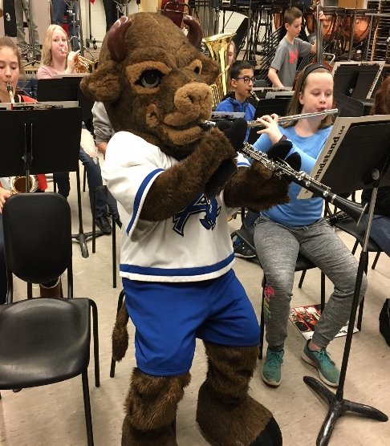
School Life

Slide 6
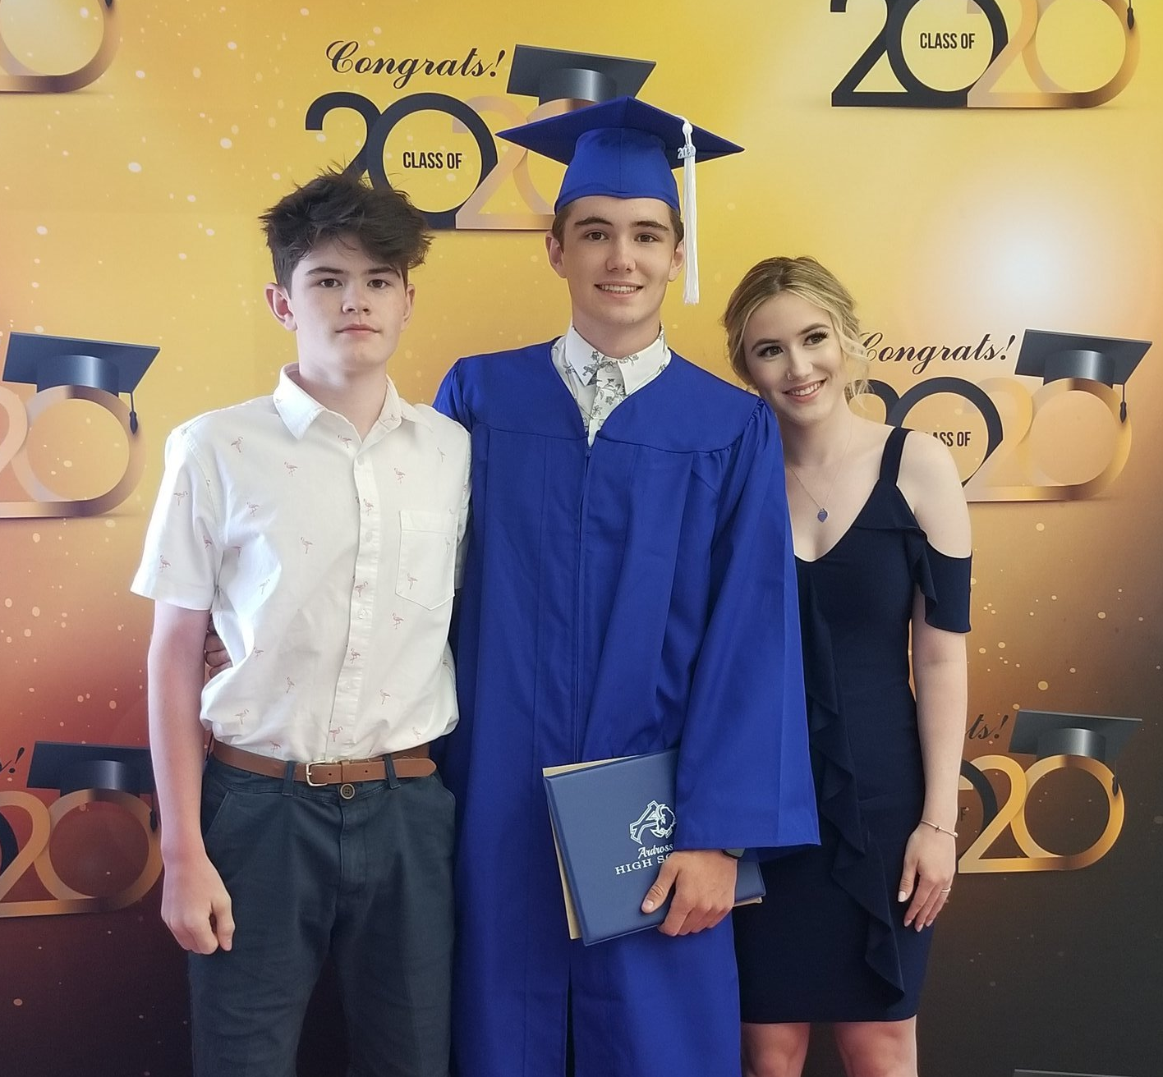
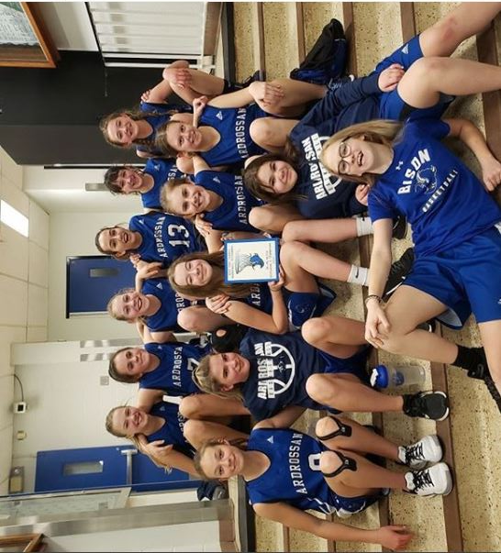
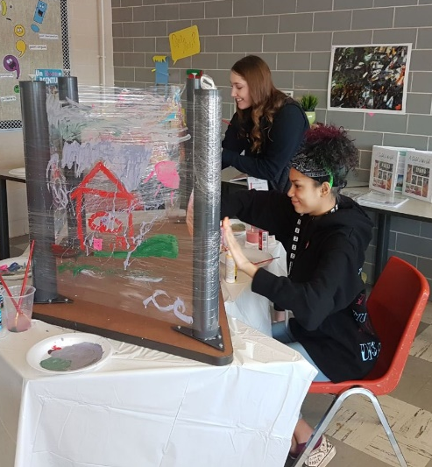
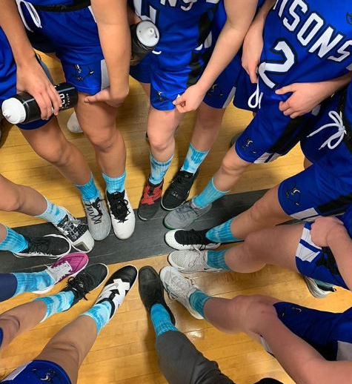
School Life

Slide 7
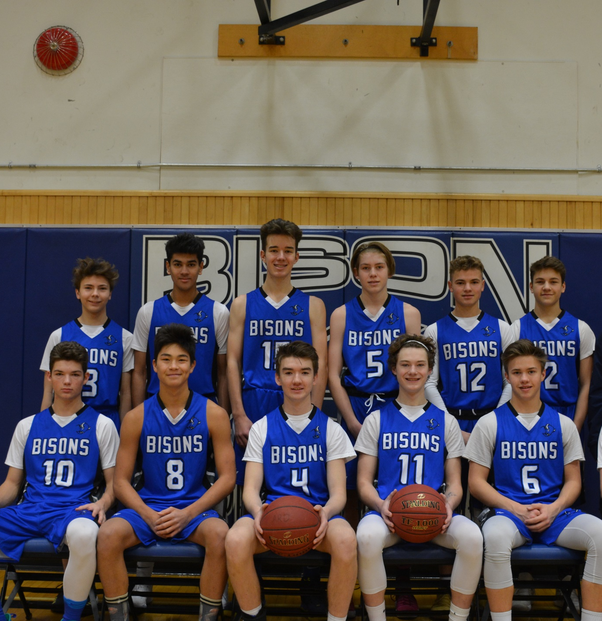
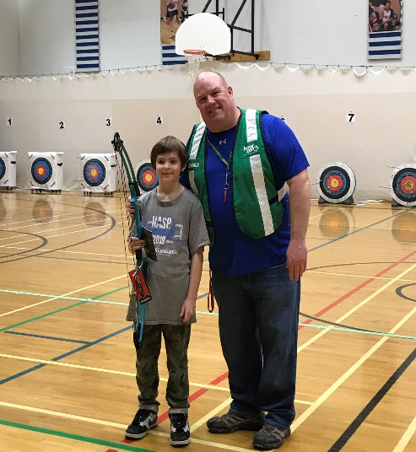
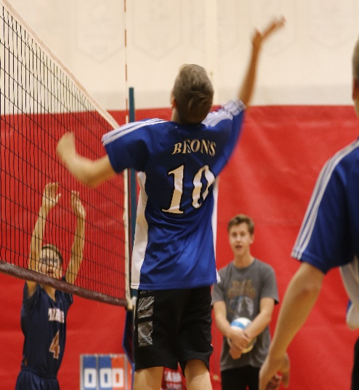
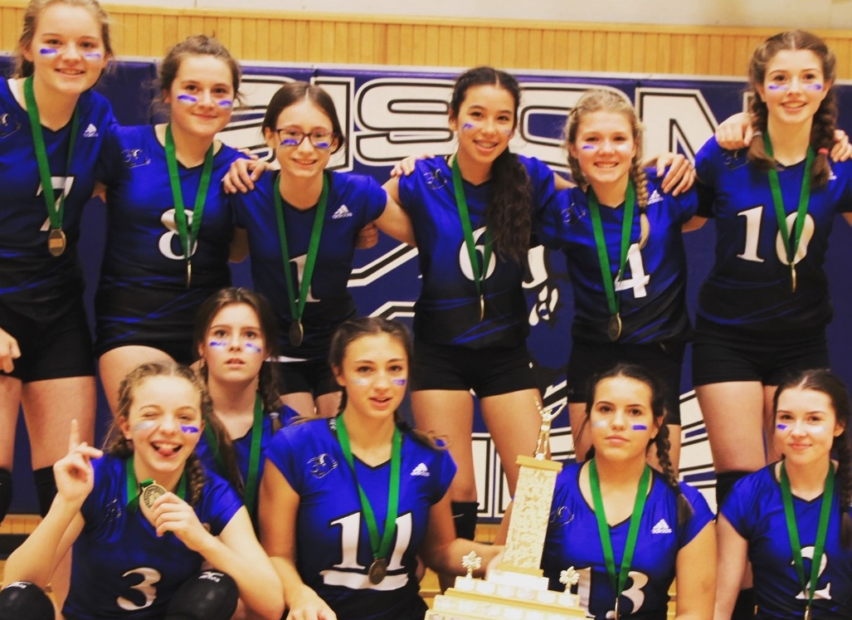
School Life

Slide 8
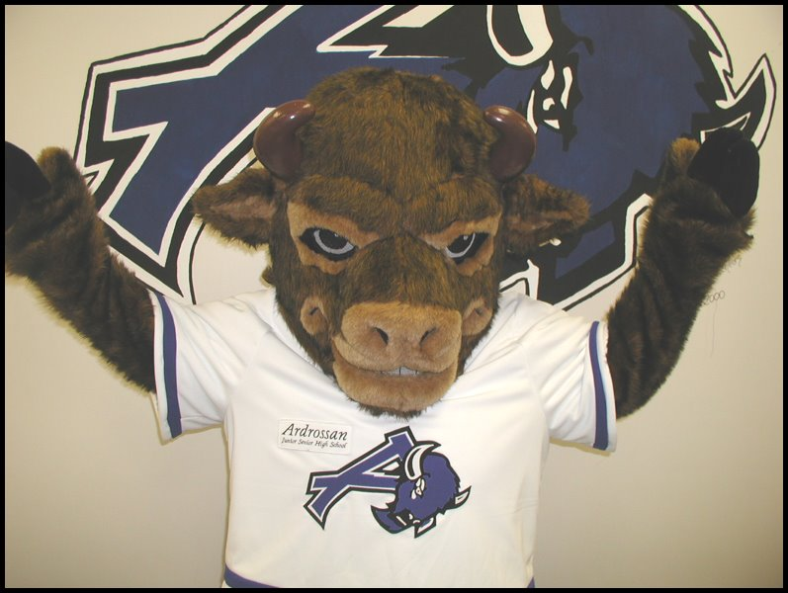
School Life

Slide 9
Academics
Our school offers a wide range of academic and hands-on programs to meet diverse students’ needs:
French Immersion
Modern Languages (French and Spanish)
Knowledge and Employability Courses
Career & Technology Studies :Communication Technology/ Construction/Foods/Fashion/Esthetics/Mechanics/Fabrication (Welding)
Environmental Education
Personal Fitness
Learning Commons (Library)
Three Computer Labs
Registered Apprenticeship Program
Wellness Centre
Two Large Gymnasiums
275 Seat Theatre

Slide 10
French Immersion
Ardrossan Jr. Sr. High School offers a French Immersion (FI) Program for Grades 7 through 12. A full program is offered at the junior high level and a variety of core courses at the senior high level. The junior high program includes French Language Arts, Science, Social Studies, Math and English Language Arts. Students in the FI Program can take advantage of cultural activities and exchanges, important educational aspects of the program. We offer the following courses in French. French Language Arts, Biology, Chemistry, Social Studies, Math at all levels as well as Science 10. We have a great retention rate from Jr. High to Sr. High year after year.
Notes:
Land and People Acknowledgement
We acknowledge with respect the history and culture of the peoples with whom Treaty 6 was signed and the land upon which Elk Island Public Schools reside. We also acknowledge the traditional homeland of the Métis Nation.
We recognize our responsibility as Treaty members and honour the heritage and gifts of the First Peoples.
We commit to moving forward in partnership with Indigenous communities in a spirit of collaboration and reconciliation

Slide 11
Some of our Programs
Languages – French Immersion/ Spanish
Wide range of CTS courses:
Communication Technology
Construction Technology
Esthetics/Fashion
Fabrication Studies
Foods and Commercial Foods
Mechanics
Environmental Education

Slide 12
Fine Arts
Arts
Commercial Arts
Band
Drama
Performing Arts
A.d.c. – Ardrossan Drama Company

Slide 13
Physical Education
Personal Fitness
Sports Performance

Slide 14
Sports Teams
X-Country
Volleyball
Basketball
Badminton
Track and Field
Archery
Cheer (Jr. and Sr. High)
Soccer (High School)
Football (High School)

Slide 15
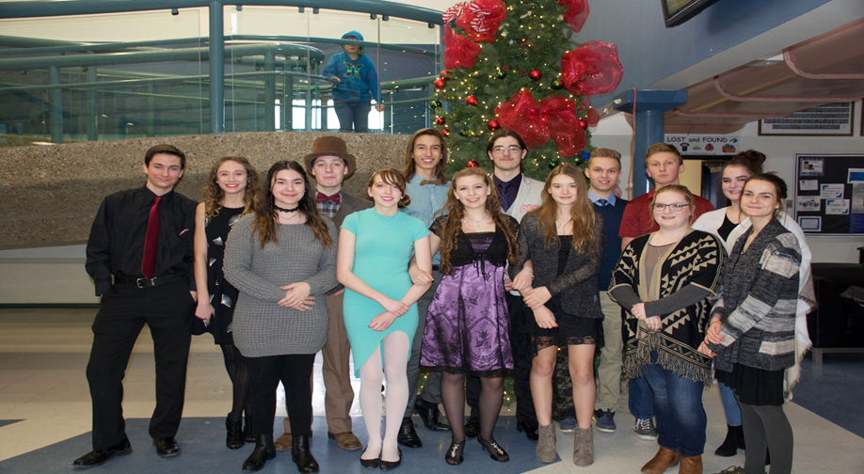
Student Council
Leadership
Volunteerism
Community

Slide 16
Pre-enrollment Process
February 1 to 28, 2021
Online through Parent Portal
Once registered, our counsellors will visit each school to assist with the registration process.
Grade 7 Orientation will take place in May 2021

Slide 17
Administration
Ms. MJ Nam, Principal, Ardrossan Jr. Sr. High School
Mr. Paul Schwartz, Assistant Principal (Grades 7,9,11)
Mr. Lonnie Hicks, Assistant Principal (Grades 8,10,12)

