Slide 1

Ardrossan Junior/Senior High School
Convocation 2021

Slide 2
Save the Date!!
Convocation Exercises will take place in the school theatre on June 24 and 25, 2021, from 10:00 AM to 5:00 PM
We will use the SCHOOL INTERVIEWS application to book your Convocation appointment. Parents will be able to book their time slot on May 28, starting at 9:00 AM. You will see reminders in Bison Tracks and via email of this date/time.

Slide 3
AJS 2021 Convocation/Red Carpet Recognition Details
The Grad may attend the Convocation/Red Carpet Recognition with 9 guests.
Arrival: Grads and parents arrive at the AJS Community Theatre. As you pull up in your car, you will be filmed walking the red carpet and while you put on your cap and gown

Slide 4
AJS 2021 Convocation/Red Carpet Recognition Details
Diploma Certificate Presentation: Parents/guests will enter the theatre to position for photographs. When parents are situated, Mr. Hicks will announce the Graduate. Parents will be invited to present the Grad their Diploma Certificate and “flip their tassel.” The Grad proceeds to the AJS backdrop and is photographed with the Principal, Ms. Nam
Theatre Departure: Grads and parents exit the theatre up the stairs and proceed to the theatre lobby. Grads are filmed while presenting a message to classmates (if they choose to do so), and parents take pictures.

Slide 5
AJS 2021 Convocation/Red Carpet Recognition Details
The Grad and parents exit the theatre lobby and collect their AJS 2021 Grad yard sign, resplendent with their Grad portrait!

Slide 6

AJS 2021 Convocation/Red Carpet Recognition: 2020 Example

Slide 7
AJS 2021 Convocation/Red Carpet Recognition: Important Considerations
The Convocation/Red Carpet Recognition is on a tight schedule. Please be on time with your guests (Grad plus nine guests).
All who attend must complete the Covid-19 Screening Questionnaire before arriving at the theatre.
Guests from households other than the Grad family must provide personal contact information in the event contact tracing becomes necessary. A link to a google form will be sent to you on May 28 for you to provide contact Information for all guests

Slide 8
AJS 2021 Convocation/Red Carpet Recognition: Important Considerations
We are prepared for each Grad to attend with nine guests. Due to time and resource requirements, we cannot change the format of the AJS 2021 Convocation/Red Carpet Recognition should Covid-19 restrictions are eased. However, if restrictions tighten, we will be required to follow the new restrictions.

Slide 9
AJS 2021 Grad News
Caps and gowns have been ordered and are arriving in the first week in June
We are still waiting on a few baby pictures for the Grad slide show. All parents missing pictures have been contacted. Please email them to me (lonnie.hicks@eips.ca) s soon as possible.
We are still waiting on a few Grad quotes for the yearbook. All parents missing pictures have been contacted. Please email them to me (lonnie.hicks@eips.ca) s soon as possible. Conversely, Mr. Hicks, or your mother, would be happy to create a quote for you. We are very creative!

Slide 10
AJS 2021 Grad News
Keep watching the AJS Grad Instagram account. Ms. Stefiuk is looking for volunteers to pick the week and school activities for Grad week. Email Ms. Stefiuk (nadine.Stefiuk@eips.ca by 11:30 AM on May 6, 2021 if you are interested.
A staff committee will be selecting a parent to present a tribute speech to the AJS 2021 Grads, and a student to present a tribute speech to the AJS 2021 Grad parents. Those selected will be notified in the first week of June.
The 2021 AJS Valedictorian (highest academic average) will be selected using Rutherford Scholarship criteria, based on marks as of June 2, 2021.

Slide 11
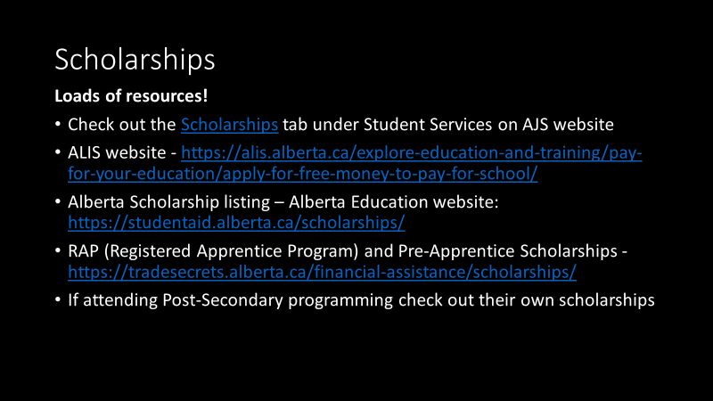

Slide 12
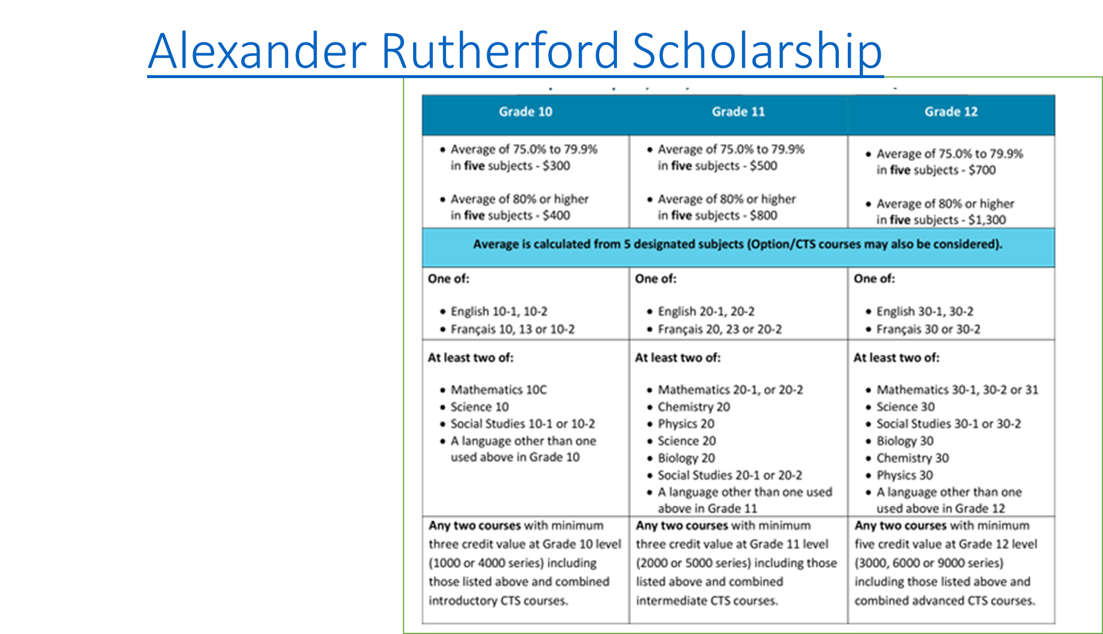

Slide 13


Slide 14

Download a copy of the Student Aid Worksheet and Funding Guide and Money 101 resources
Money 101: Budgeting Basics for Further Education is written for high school students and those already engaged in post-secondary studies. It provides information and tips about basic money management and how to finance post-secondary education.
Download your own copy at: https://alis.alberta.ca/tools-and-resources/content/products/money-101-budgeting-basics-for-further-education/

Slide 15
Questions?

